Slide 1
s-SNOM Measurements
November 2, 2017
Leaky wave antenna, design #4 (more asymmetric)
Under linear polarization
k vector parallel to TL

Slide 2
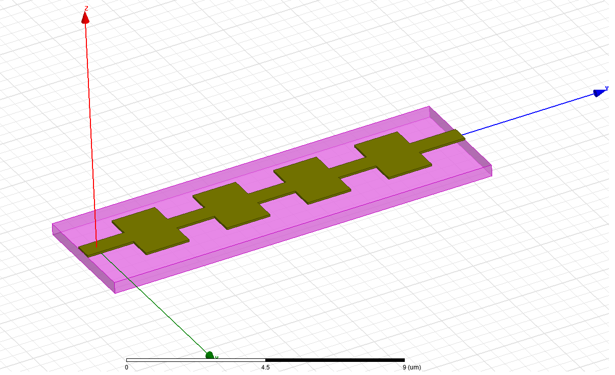
Illumination conditions
Incident wave θ = 60º
Light: linear polarization
Incidence: p-polarization (k and E vectors are in the YZ plane)
Structure A3 and E4
In the AFM, under tapping mode, different ‘setpoints’ were tested. The setpoint value is directly proportional with the amplitude of cantilever vibration
Z
E_{i}
Y
θ
k-vector
X

Slide 3
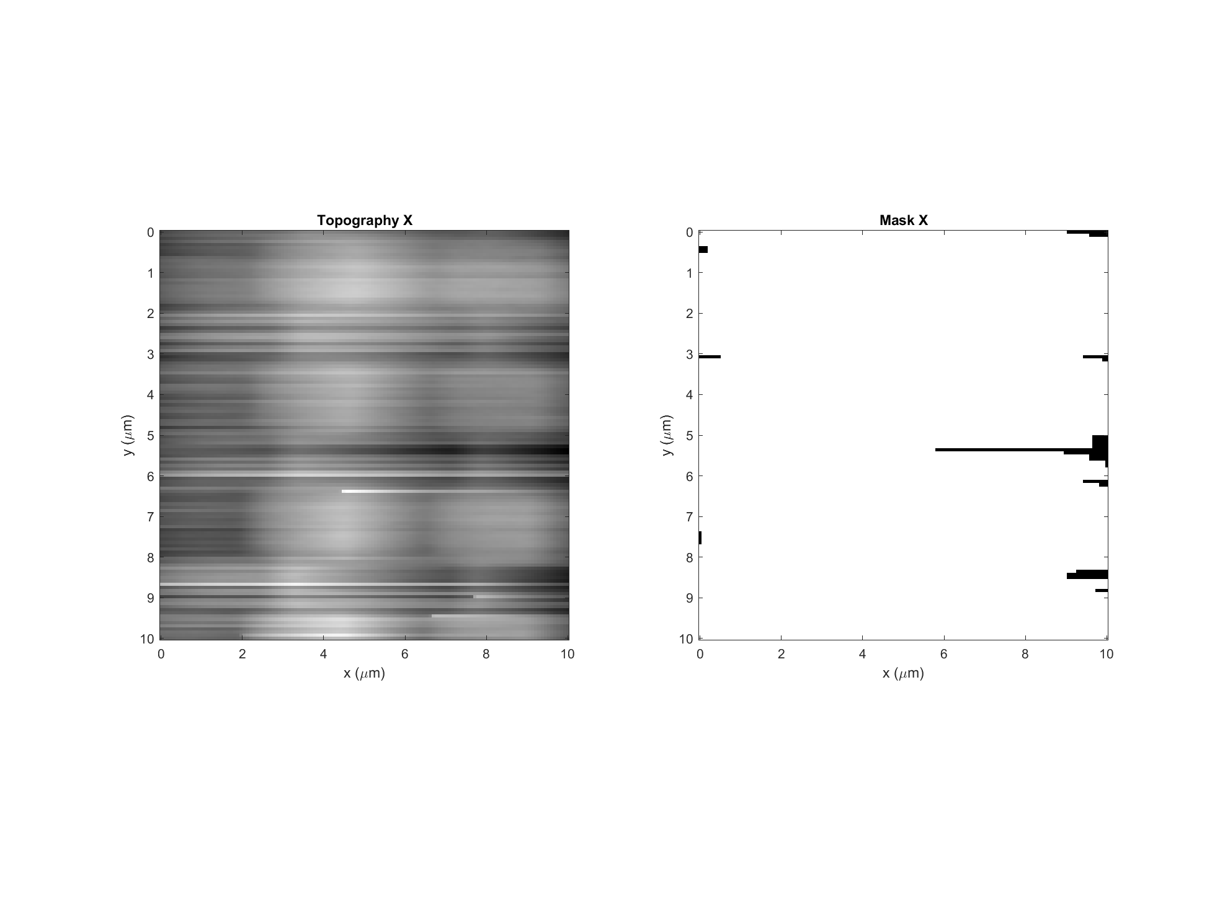
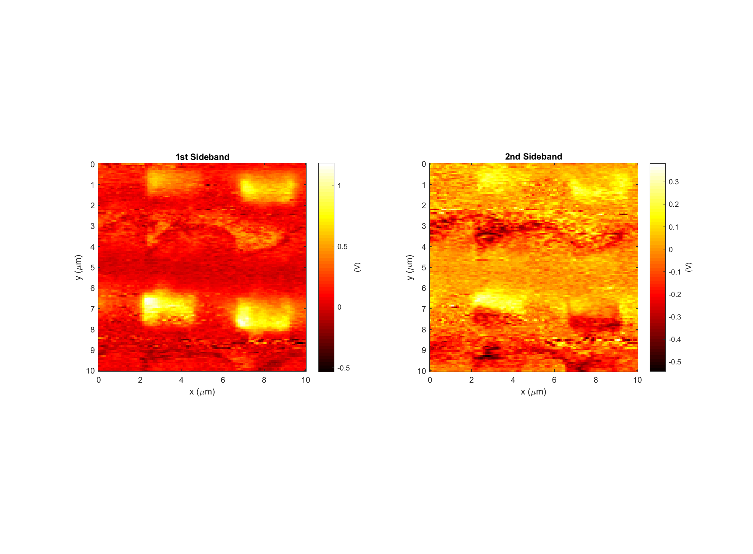
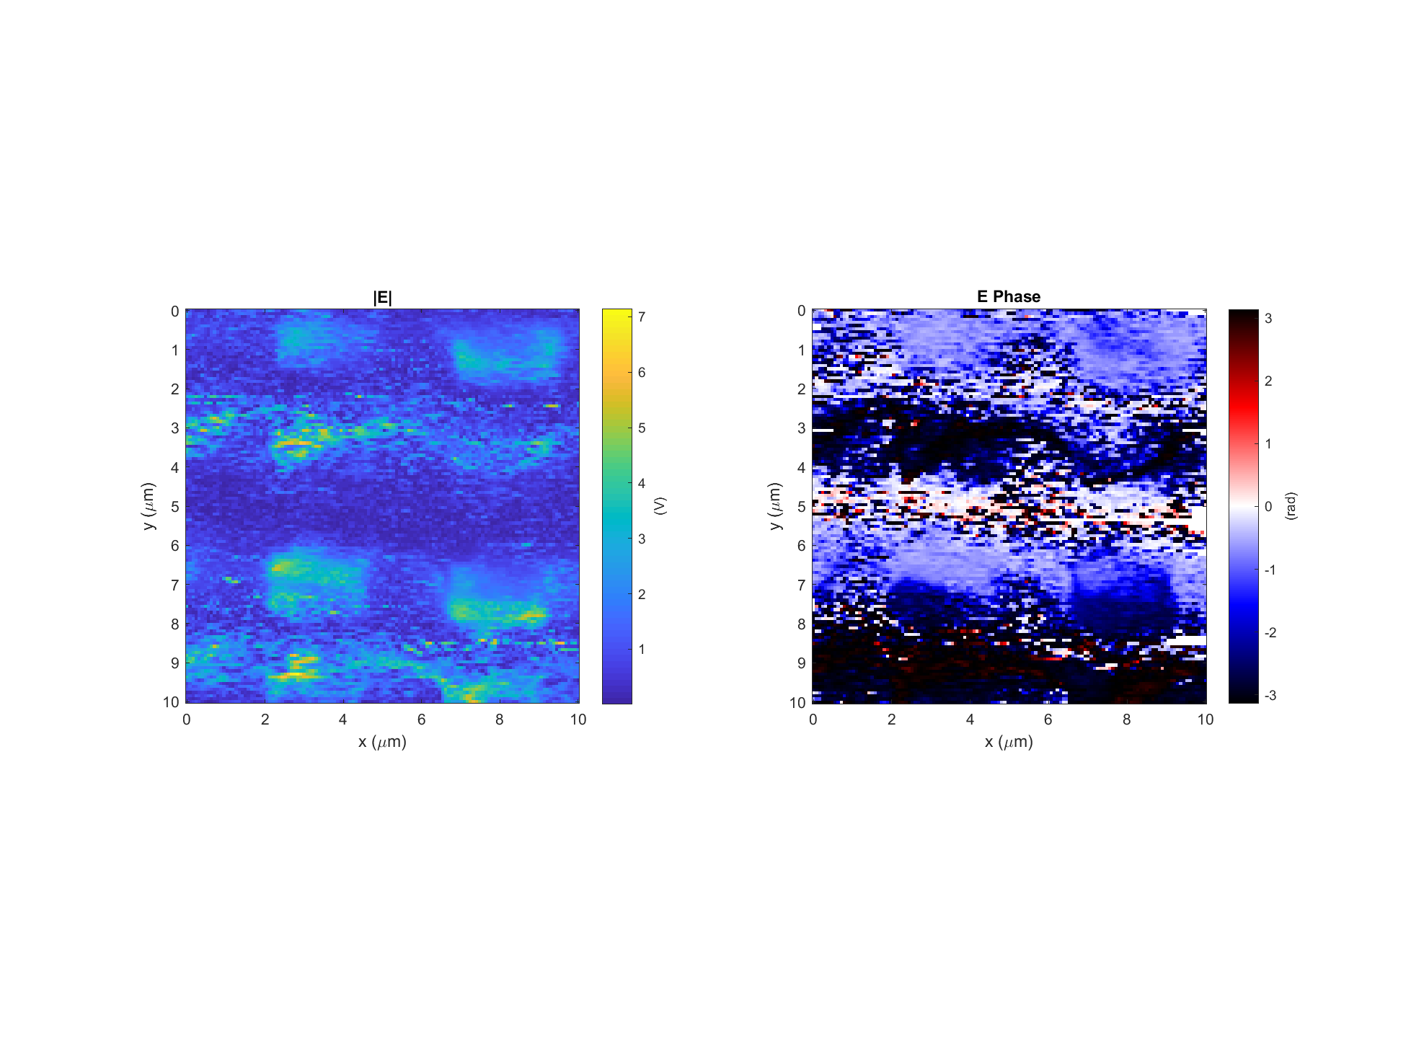
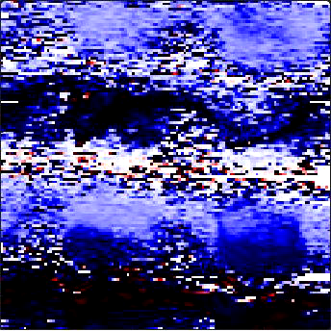
Leaky wave antenna, design #3 (E3)
Data: 2017-11-29_leaky_E3_PH_X_6 Setpoint=1.46 V
k
Light incident from below

Slide 4
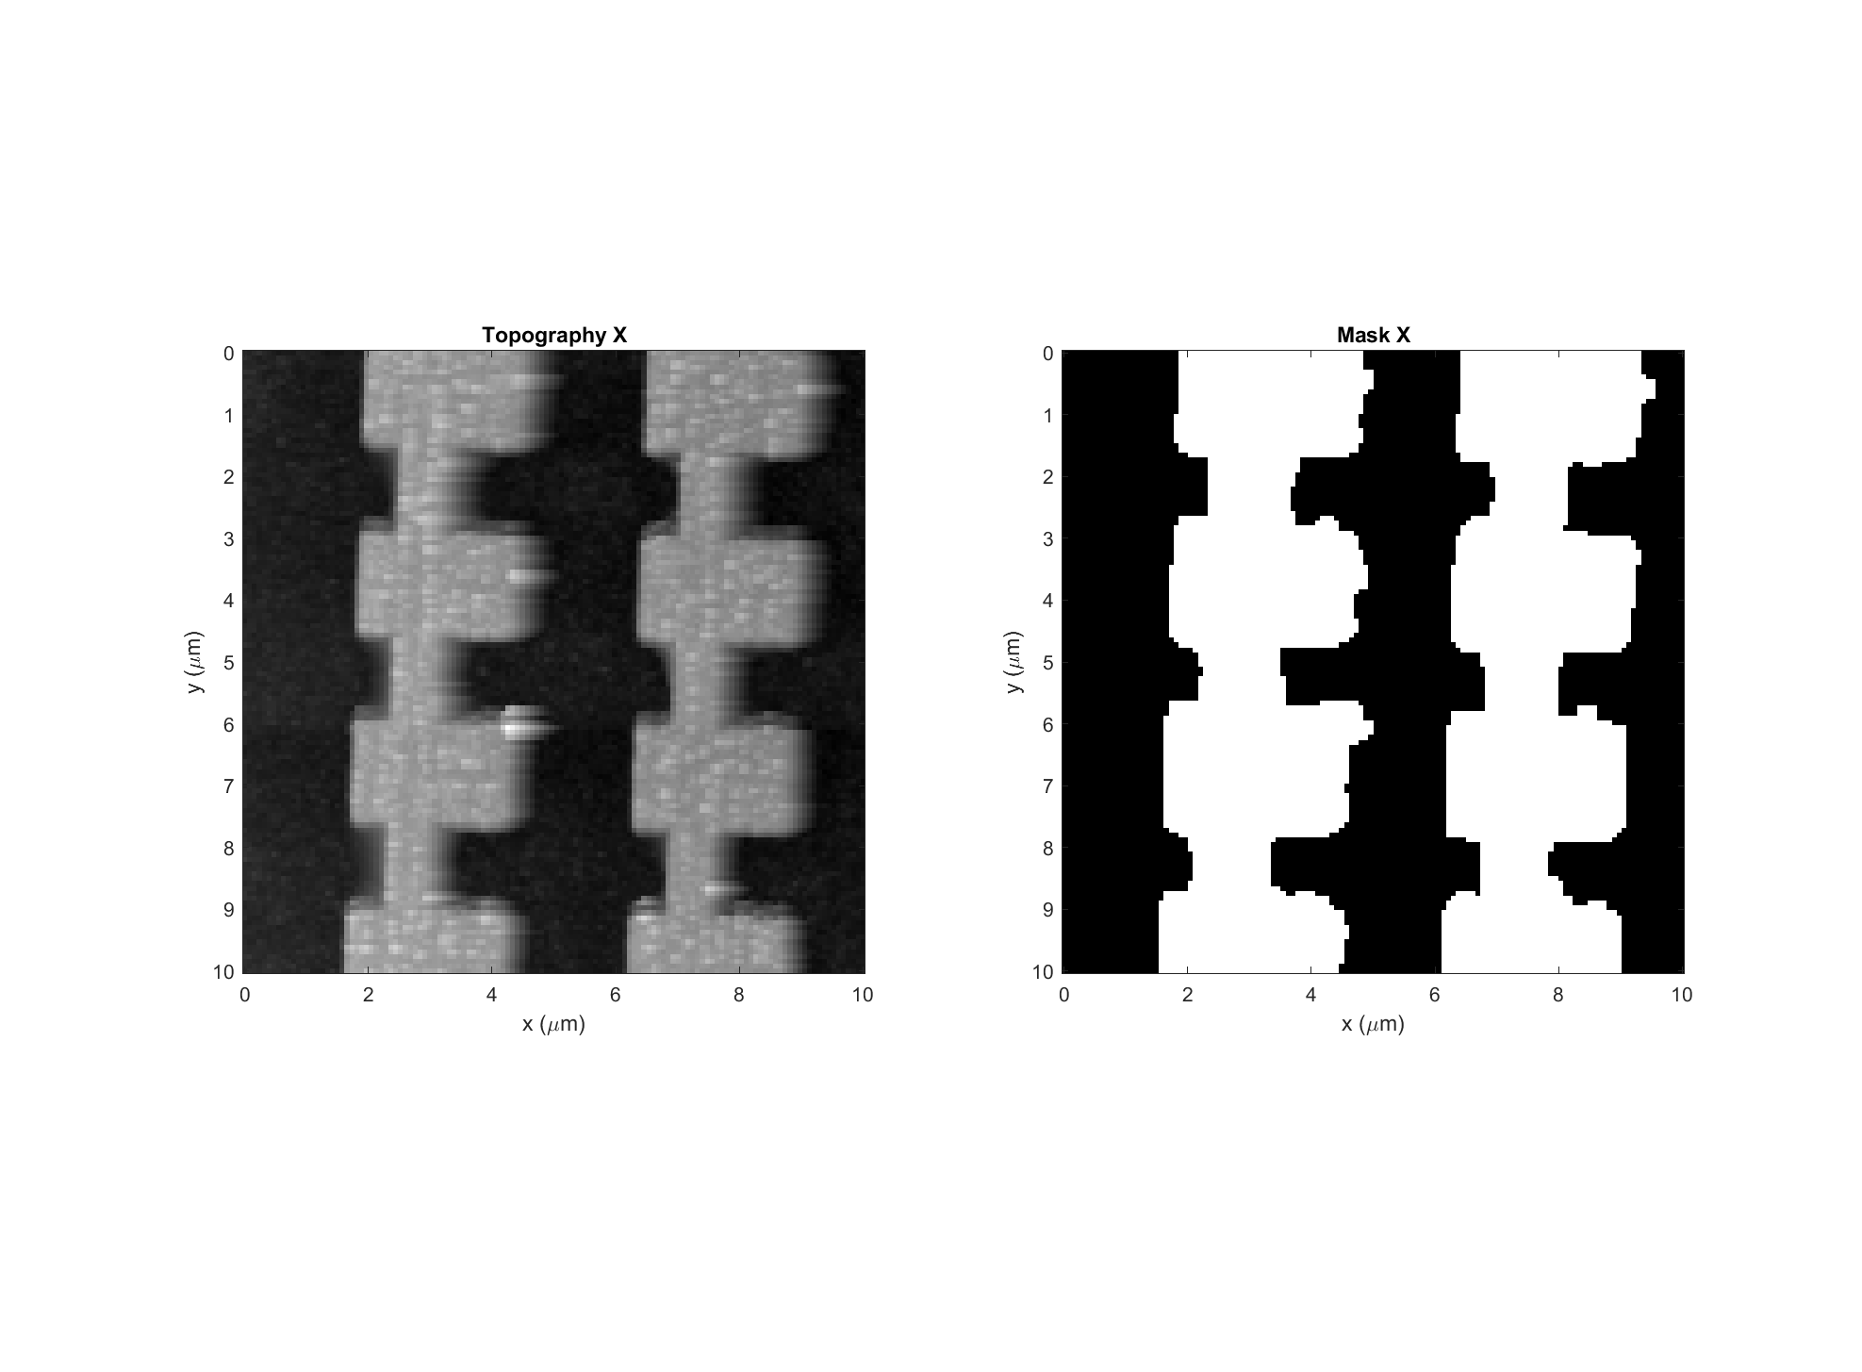
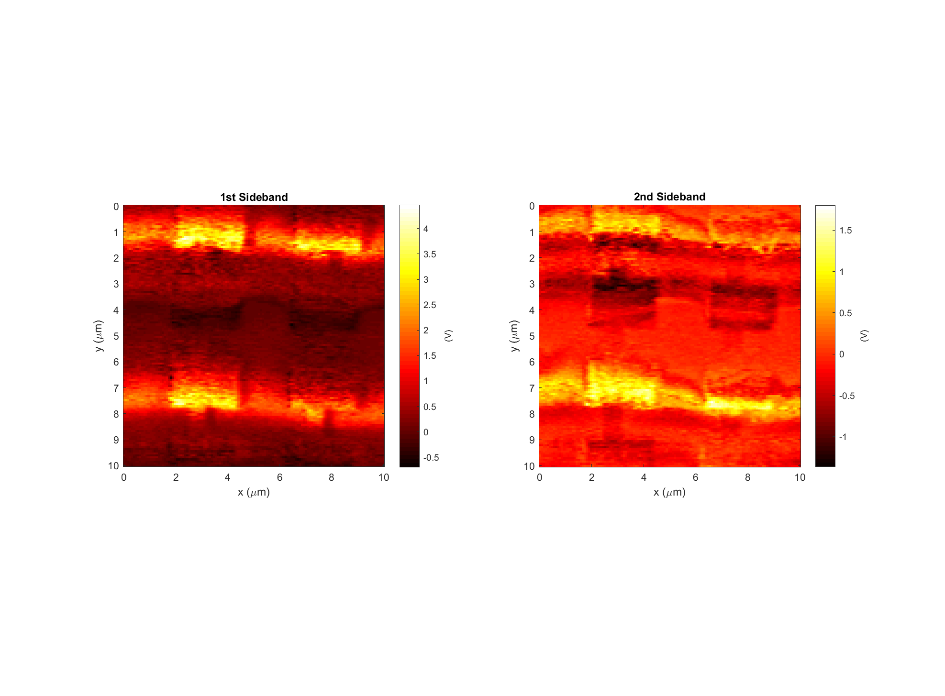
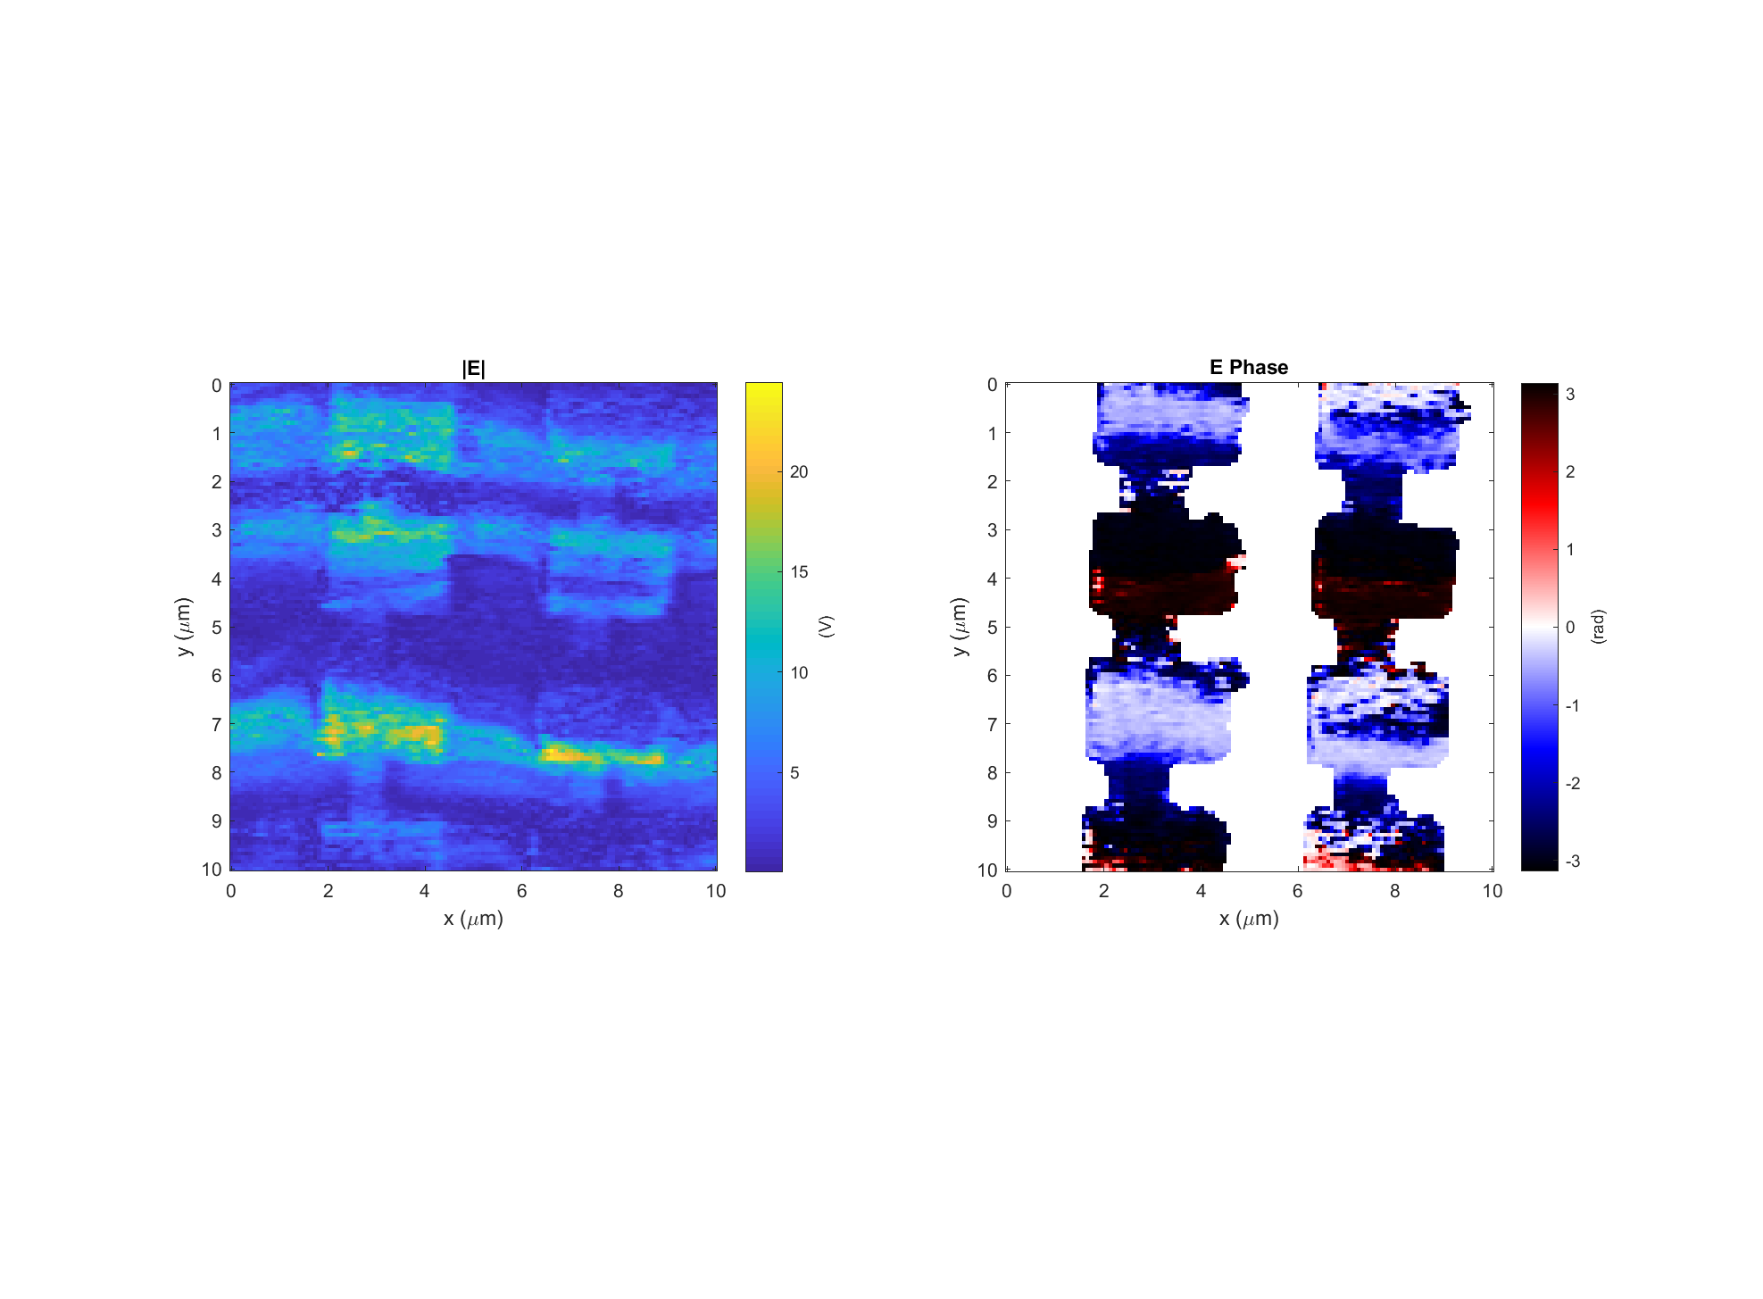
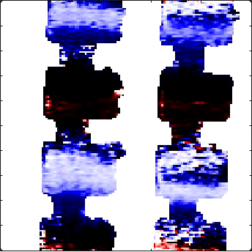
Leaky wave antenna, design #3 (E3)
Data: 2017-11-29_leaky_E3_PH_X_4 Setpoint=1.40 V
k
Light incident from below

Slide 5
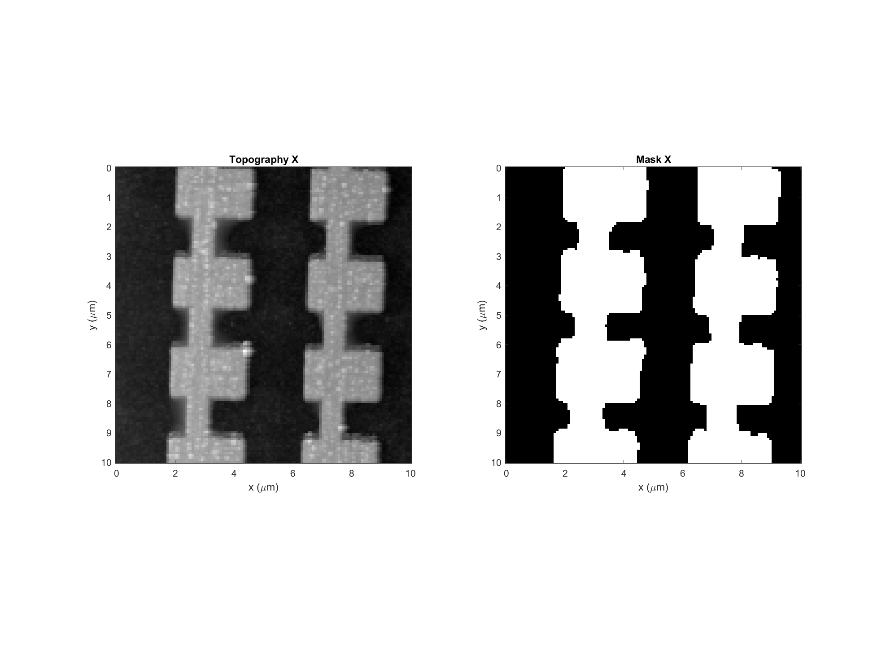
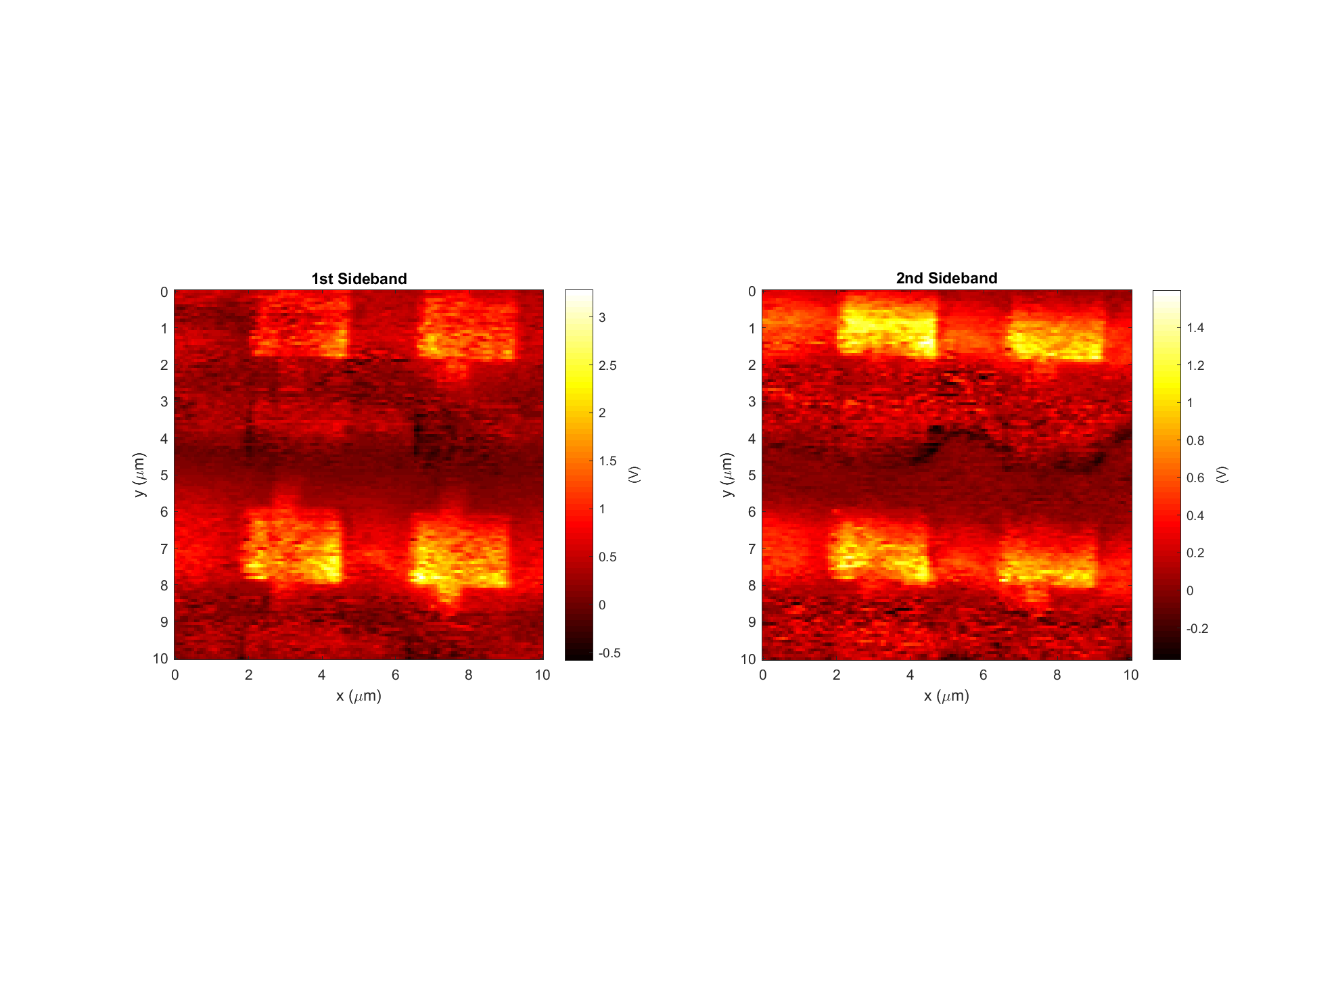
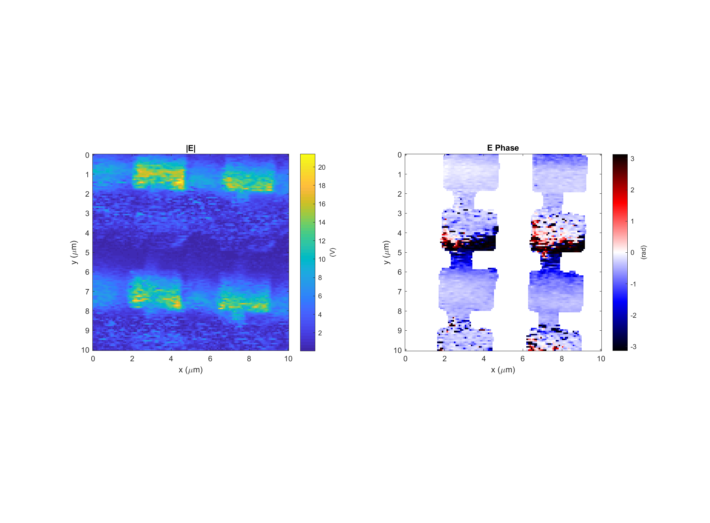
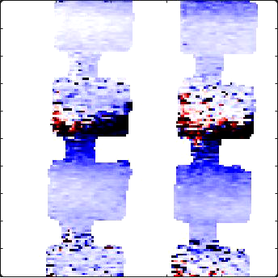
Leaky wave antenna, design #3 (E3)
Data: 2017-11-29_leaky_E3_PH_X_3 Setpoint=1.30 V
k
Light incident from below

Slide 6
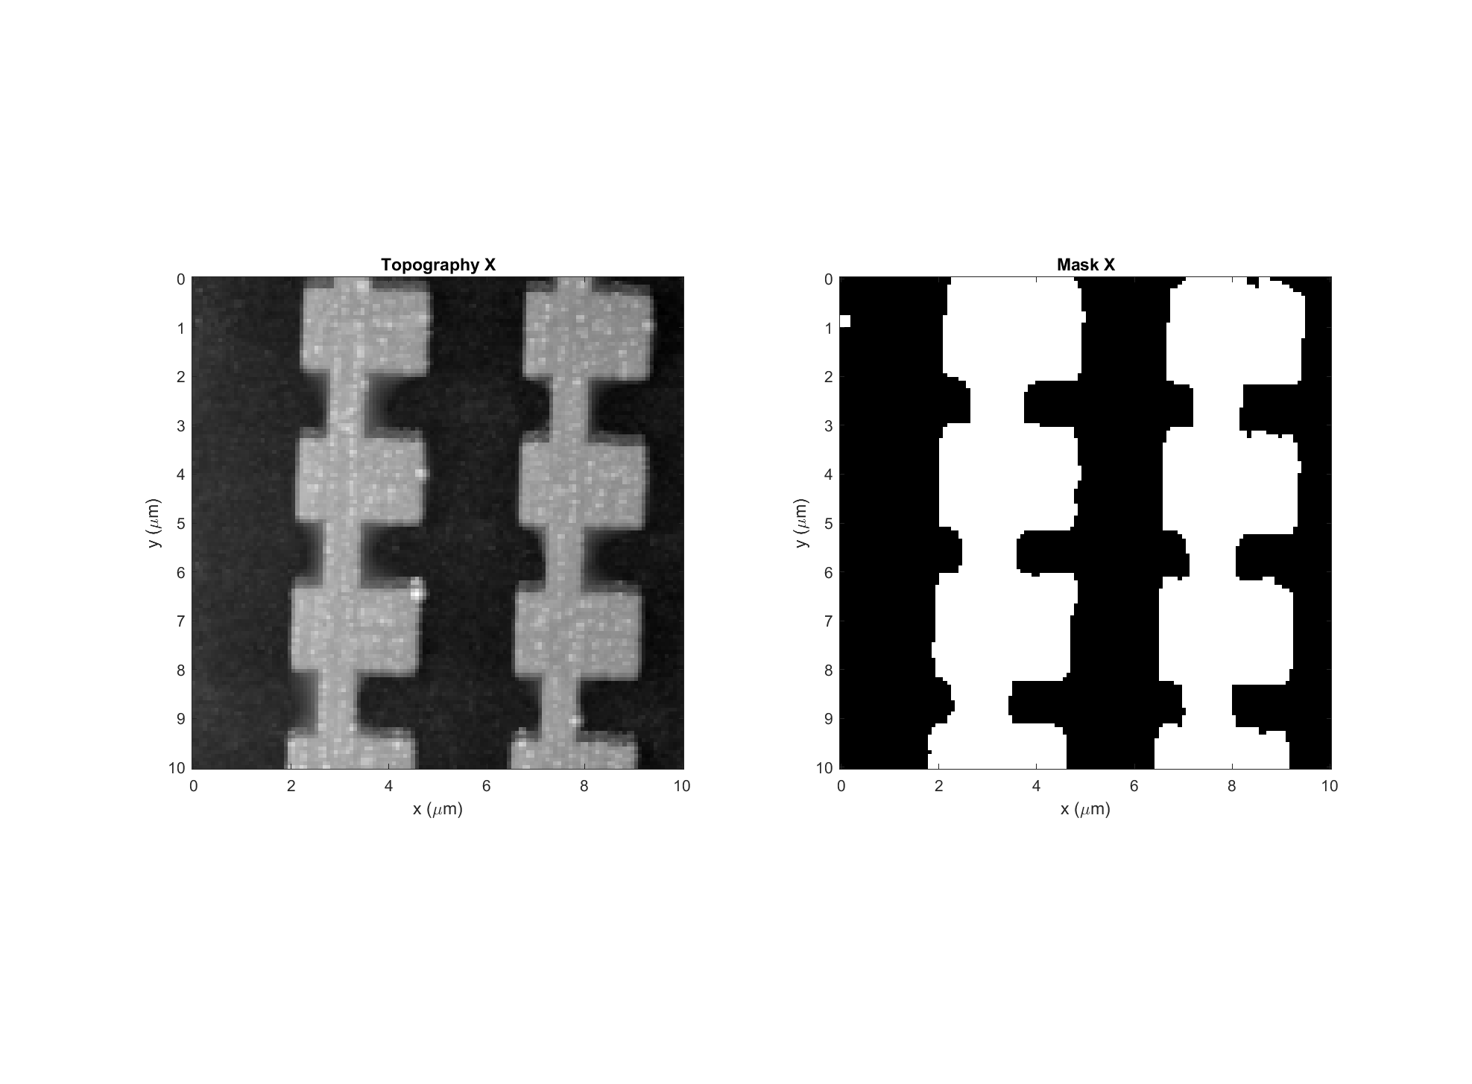
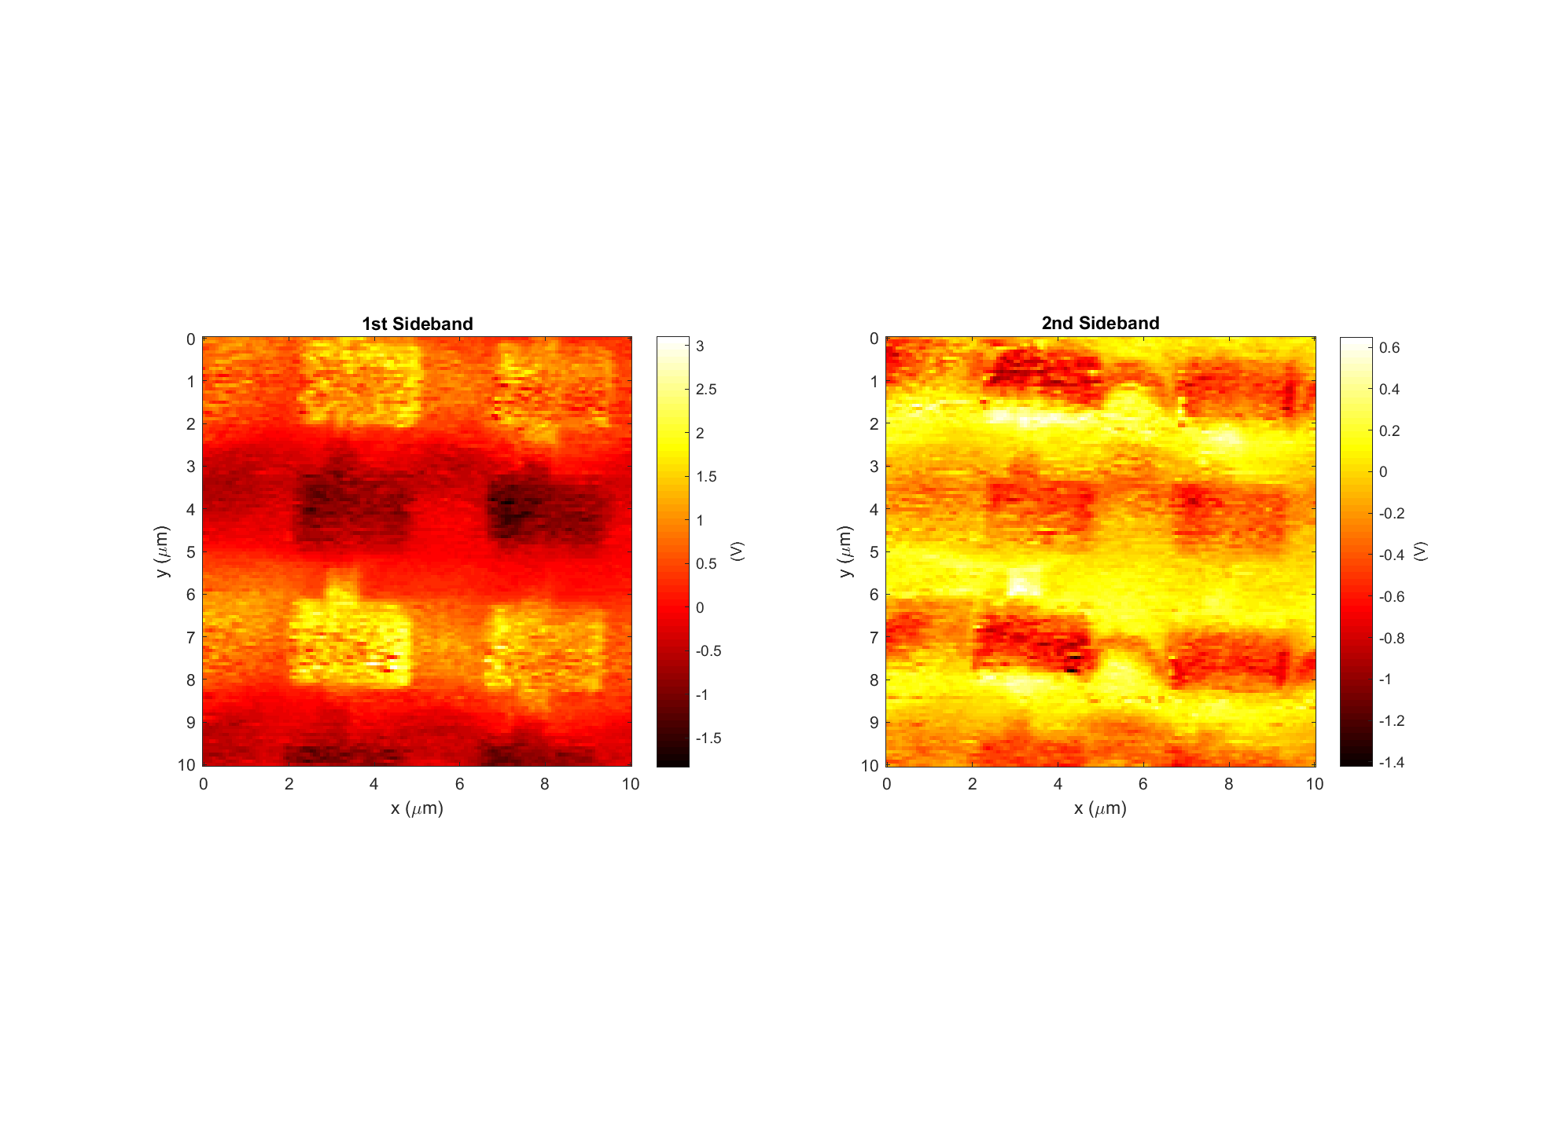
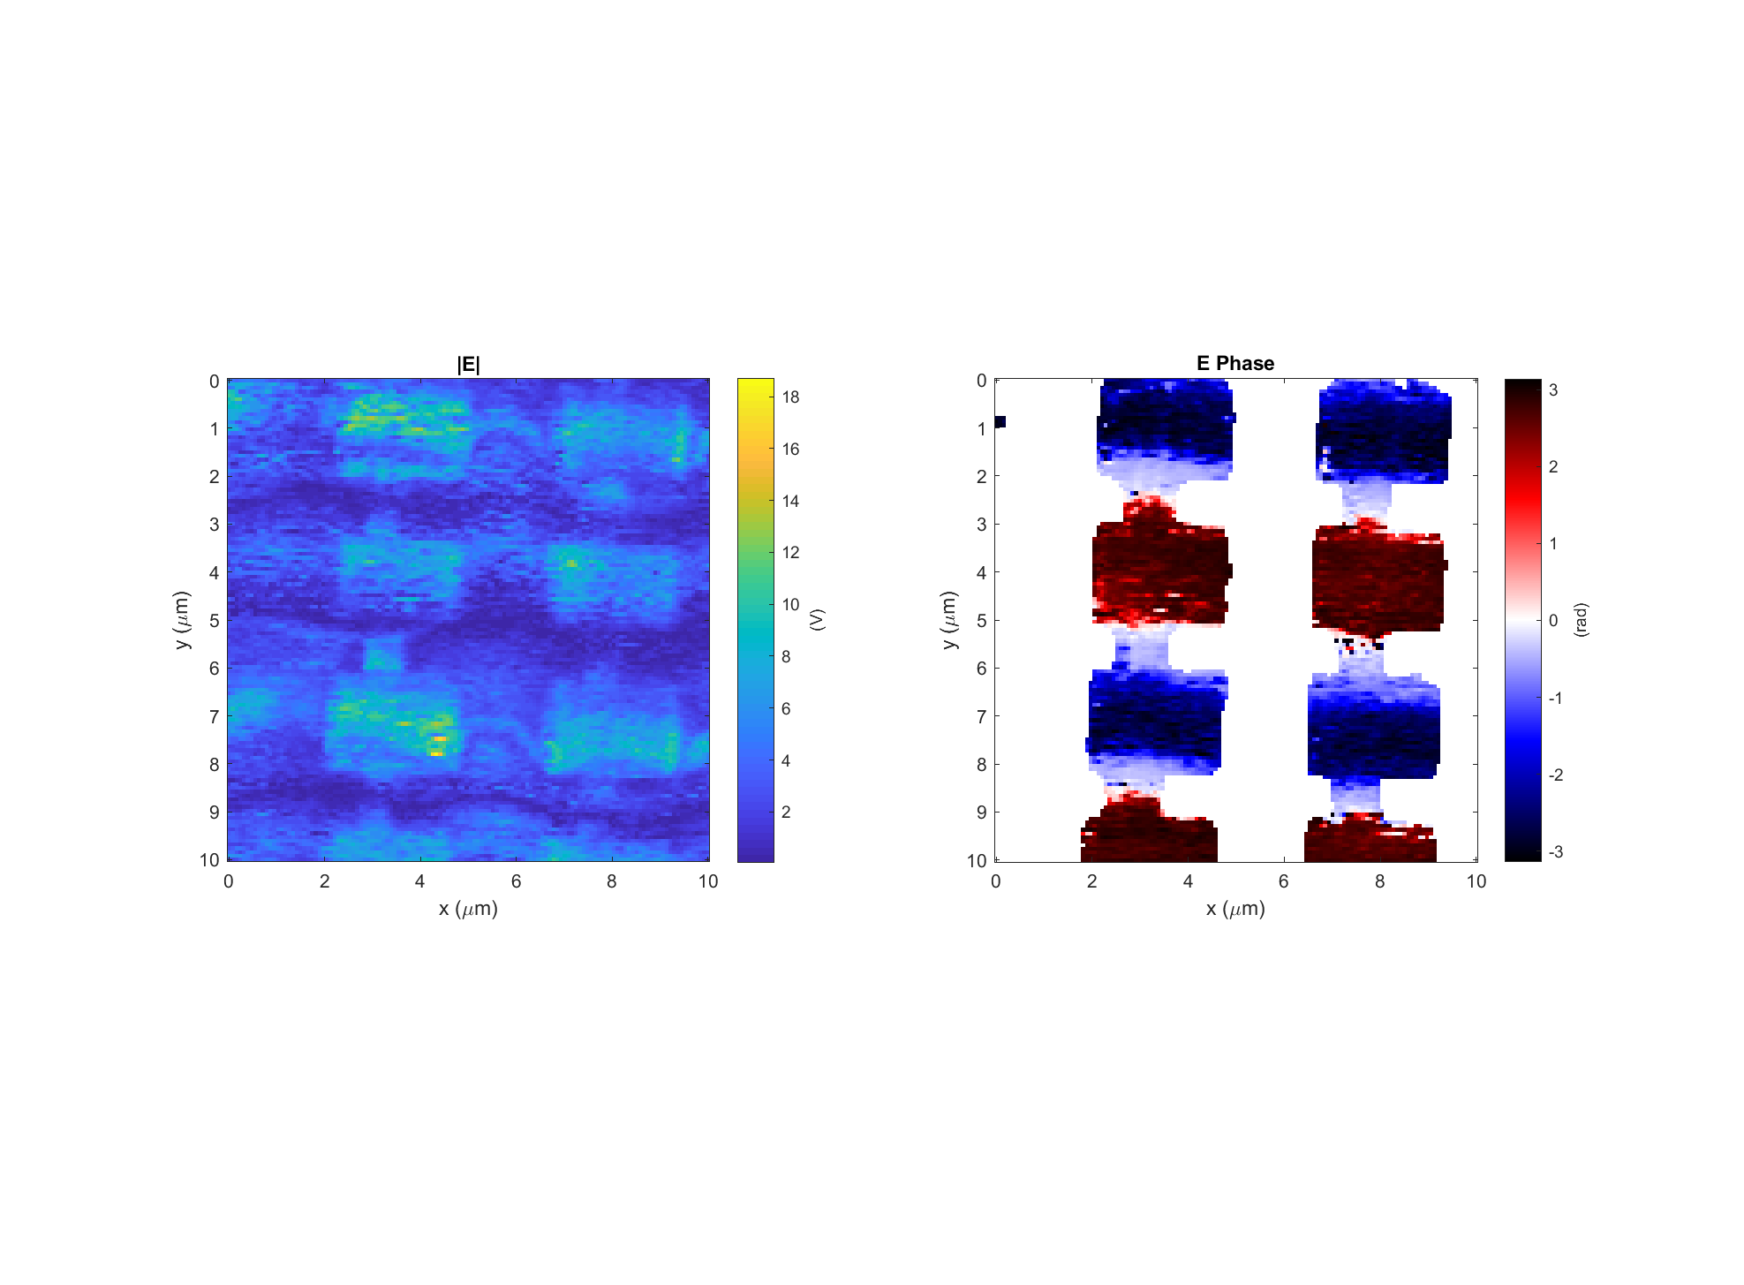
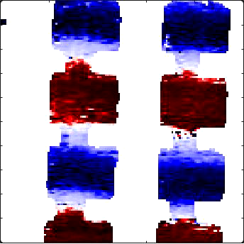
Leaky wave antenna, design #3 (E3)
Data: 2017-11-29_leaky_E3_PH_X_2 Setpoint=1.2311 V
k
Light incident from below

Slide 7
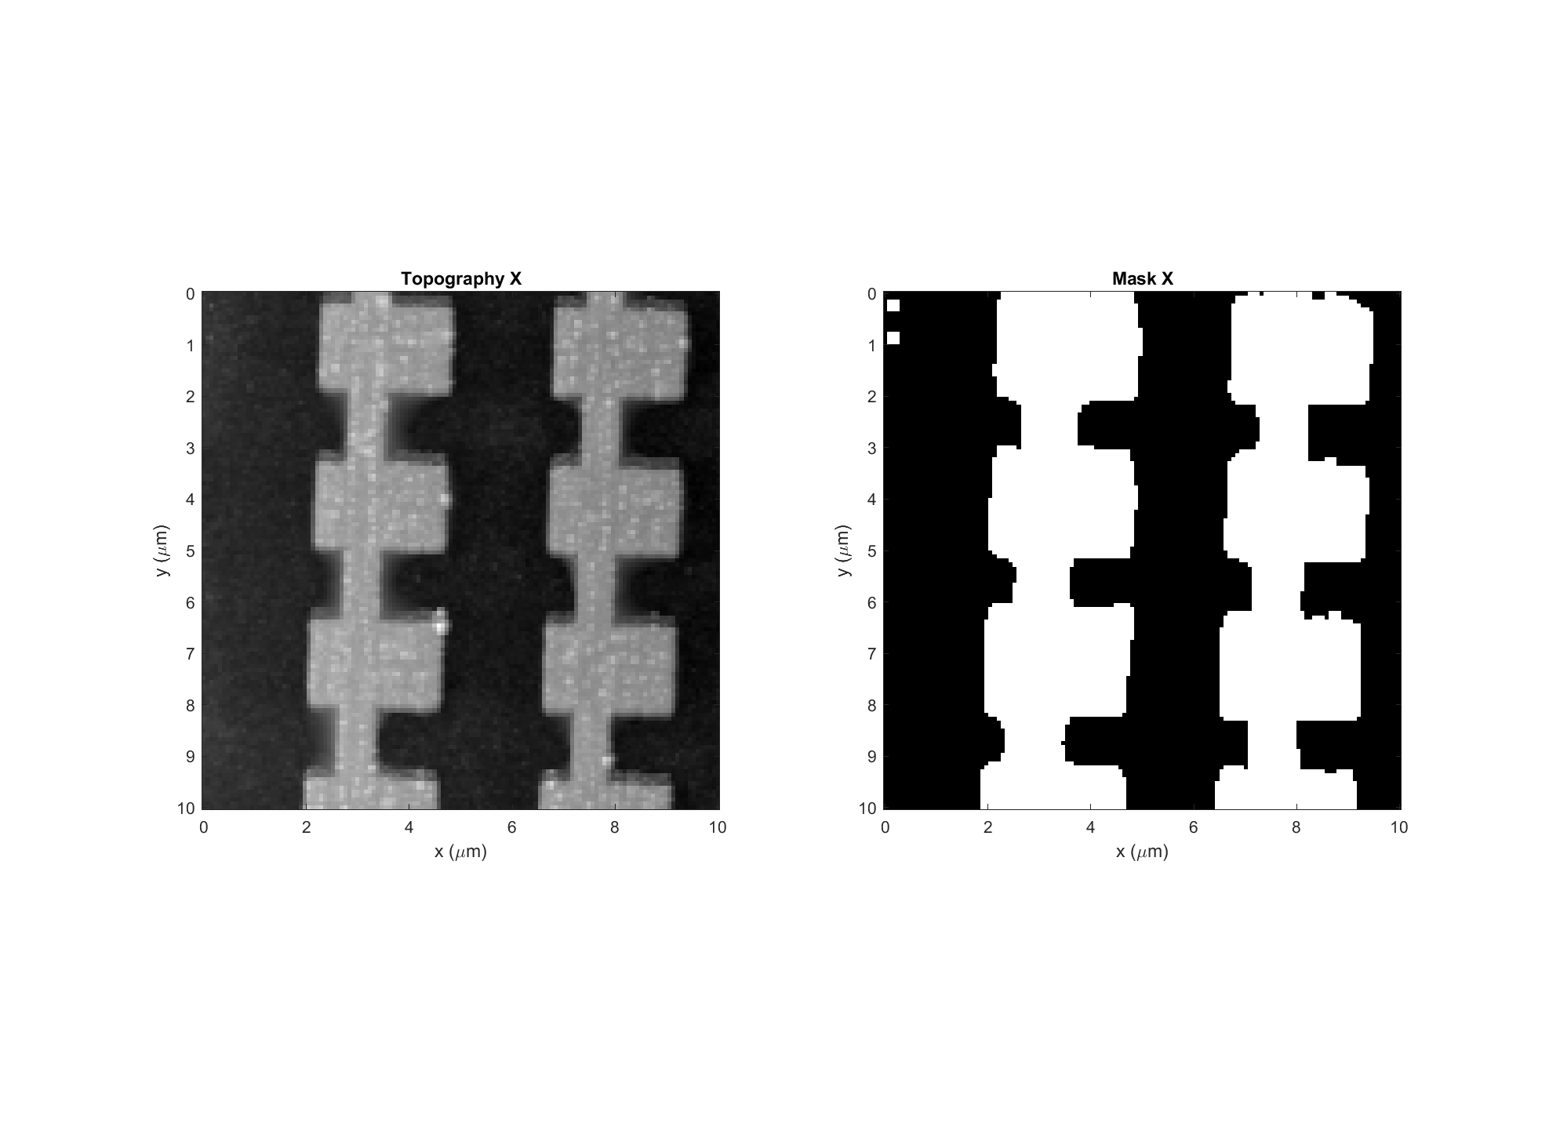
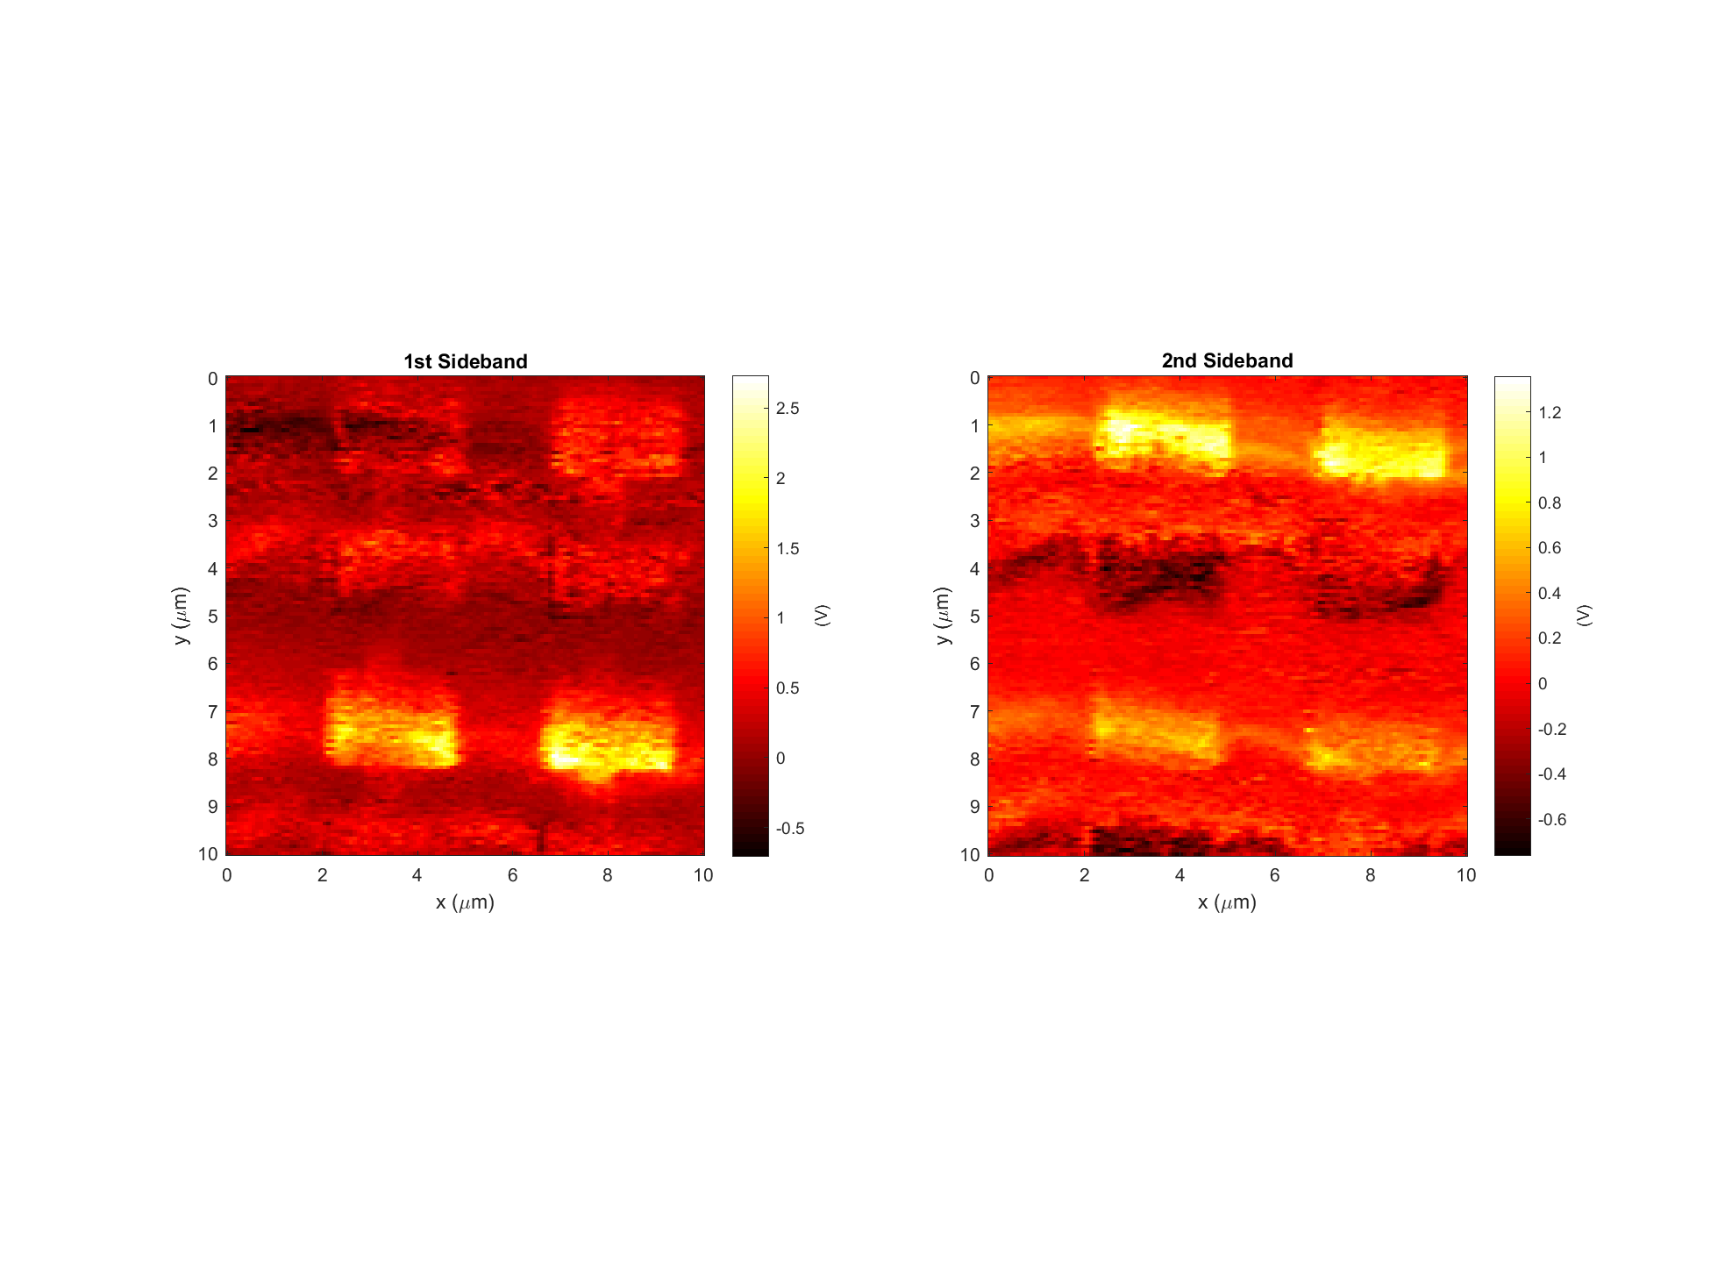
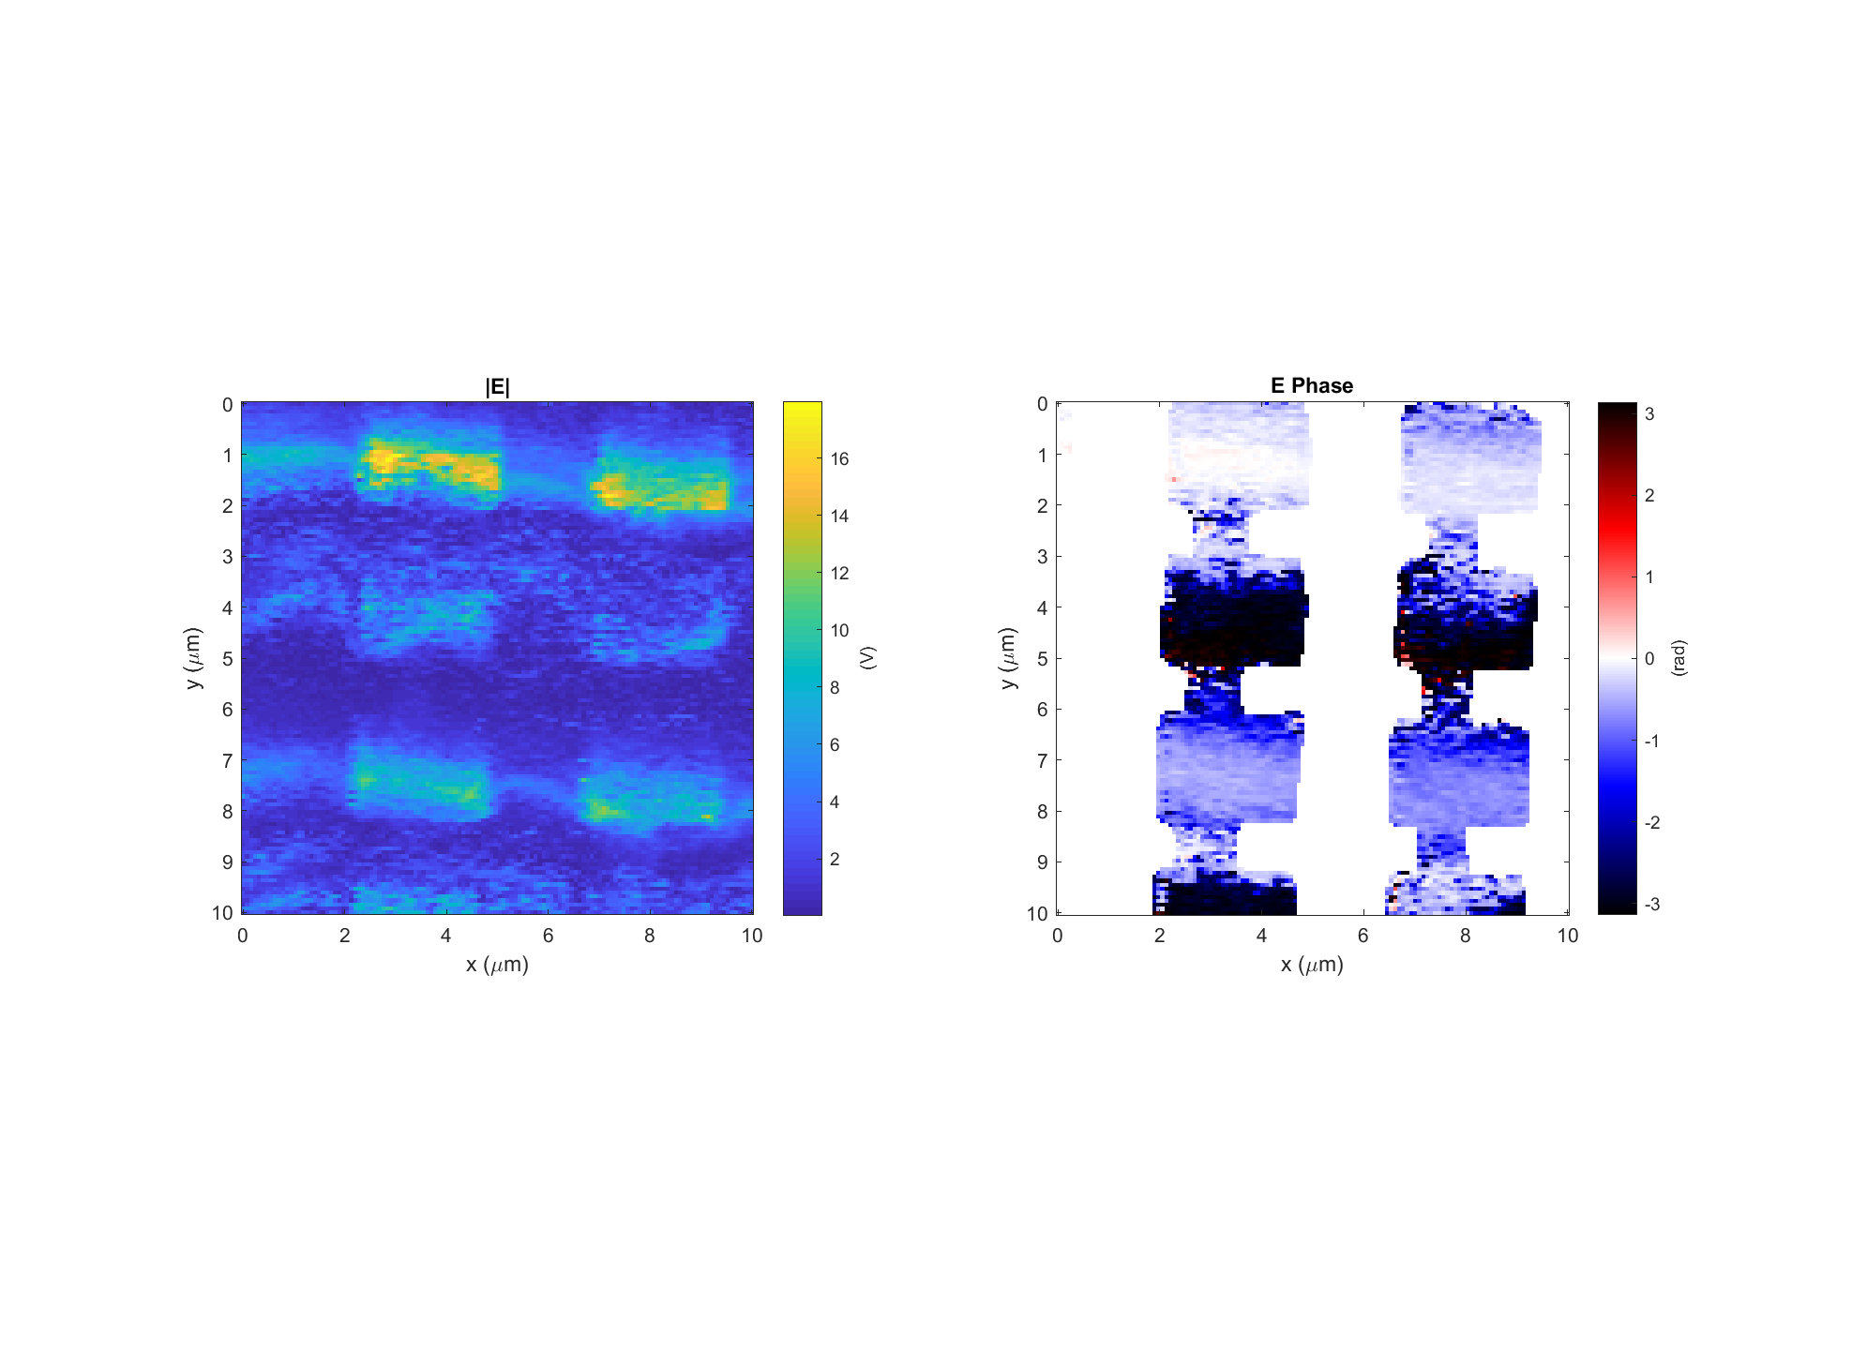
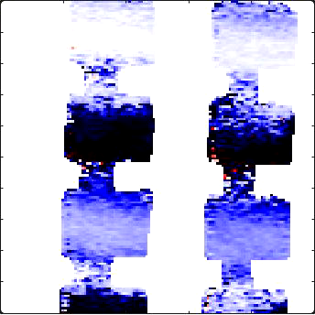
Leaky wave antenna, design #3 (E3)
Data: 2017-11-29_leaky_E3_PH_X_8 Setpoint=1.22 V
k
Light incident from below

Slide 8

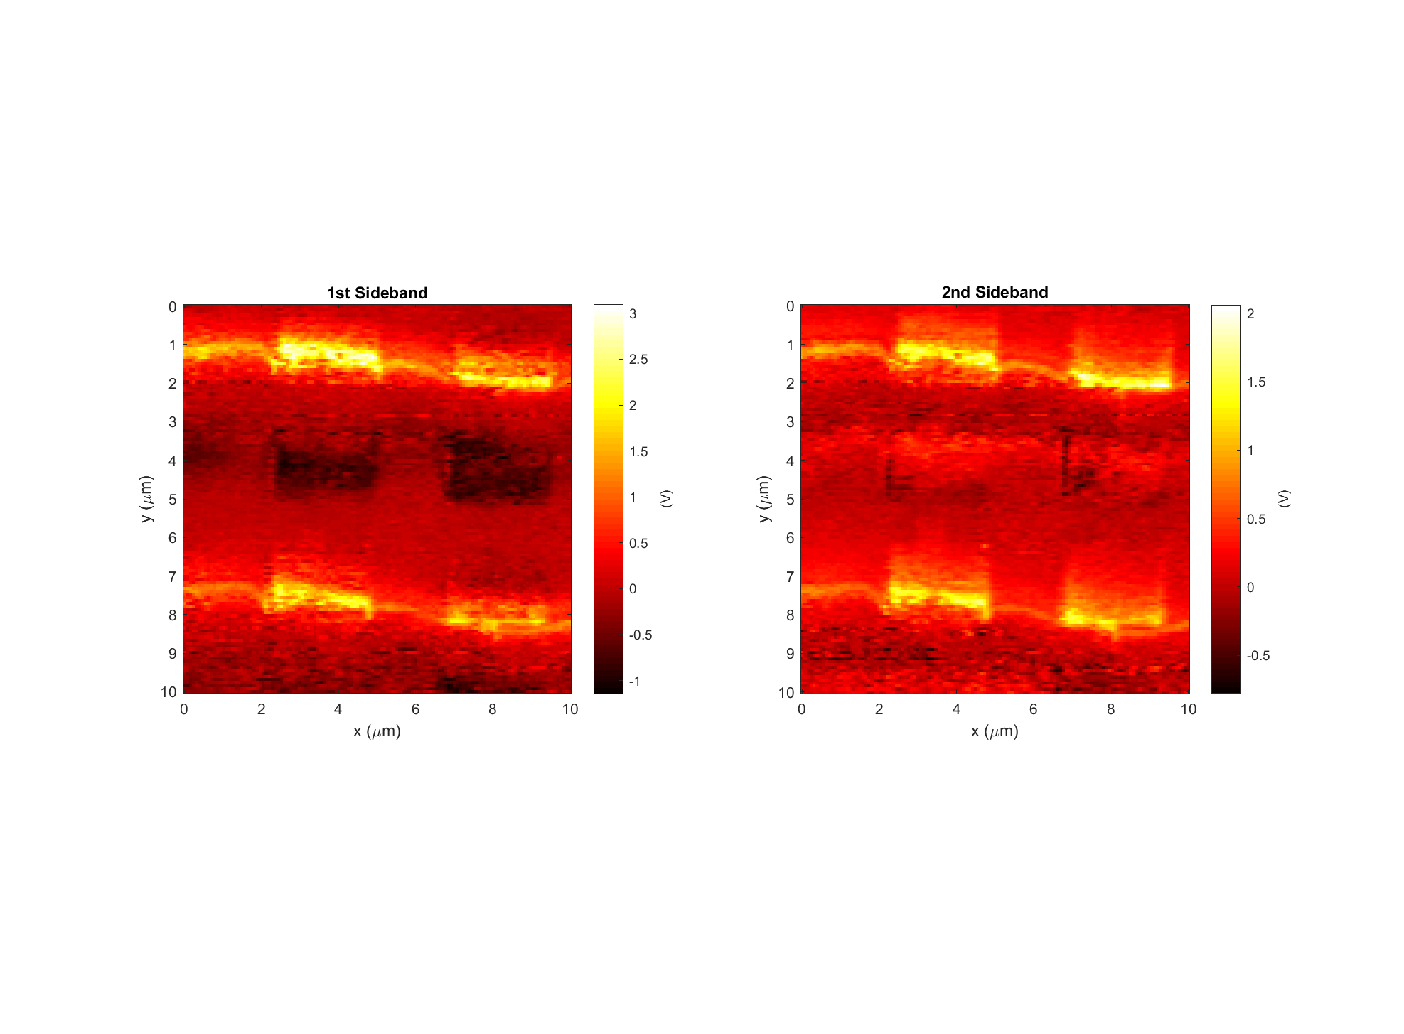
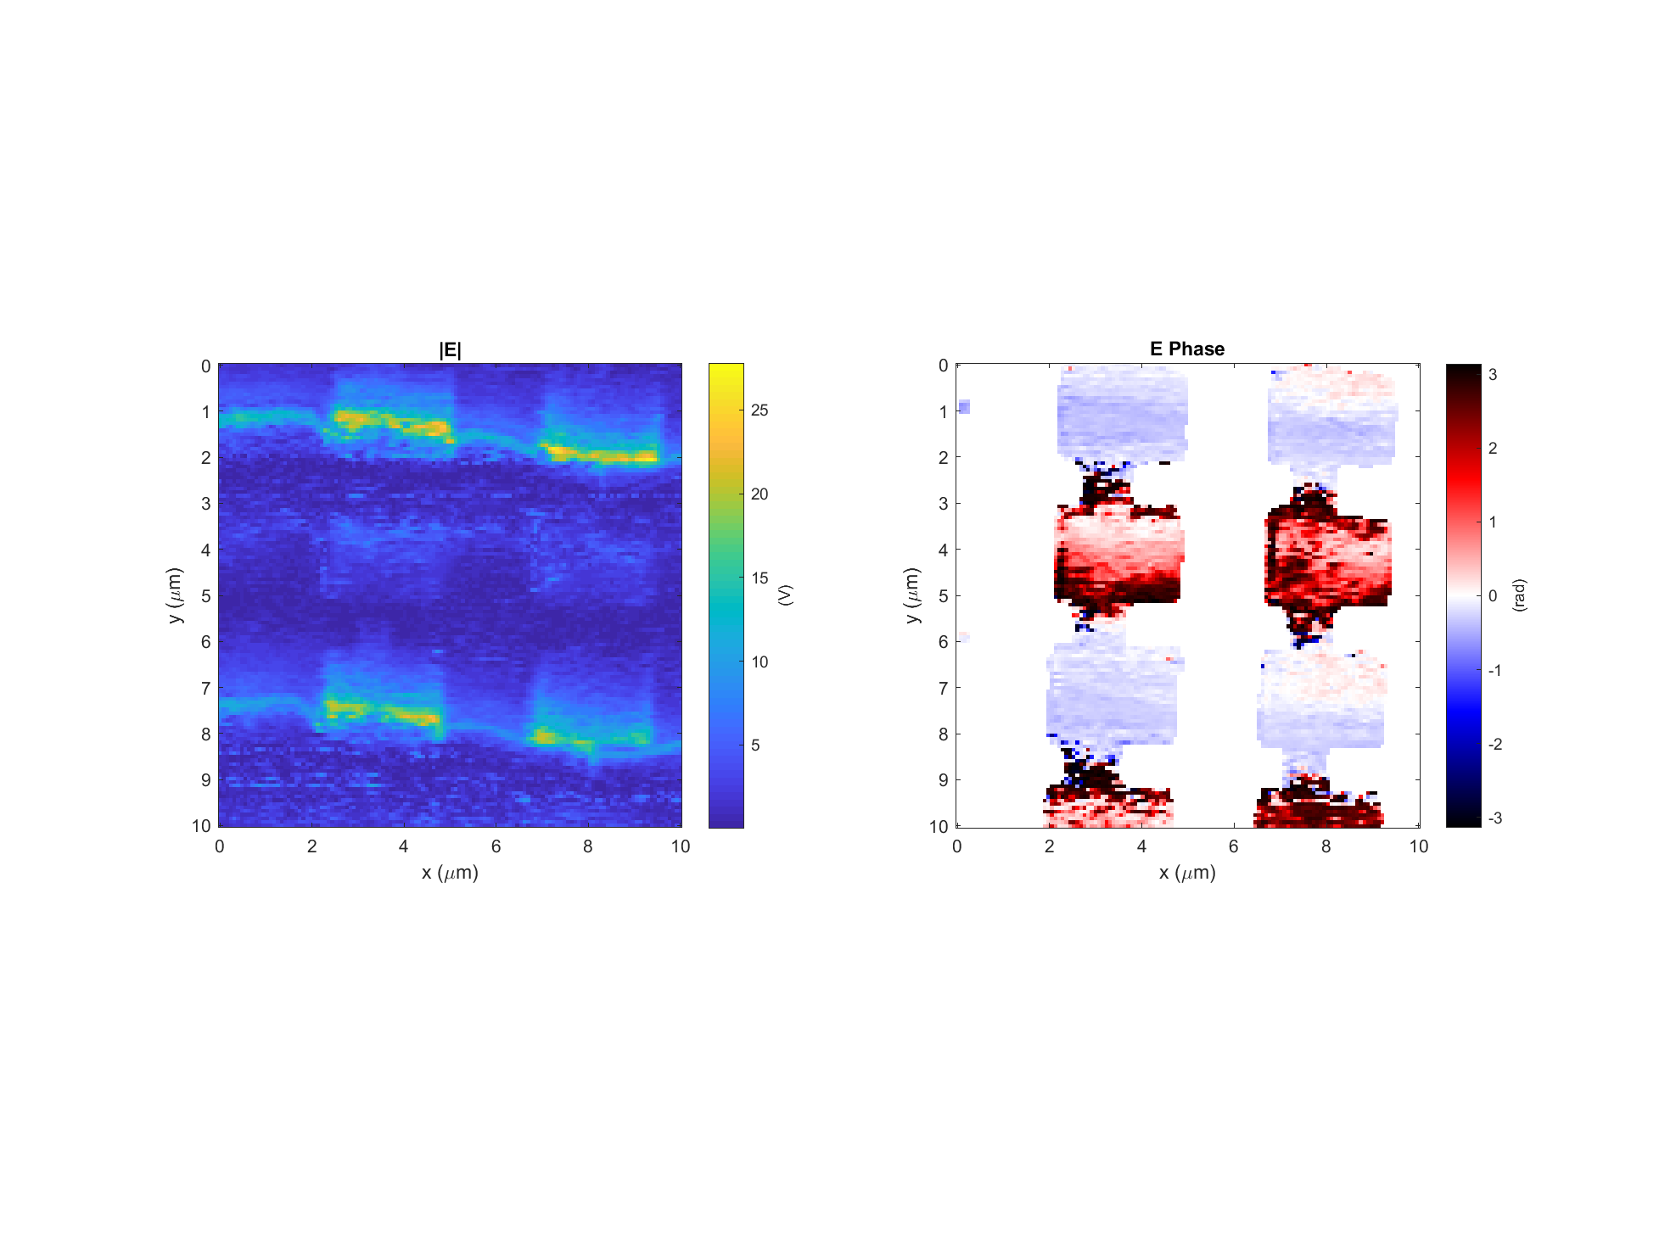
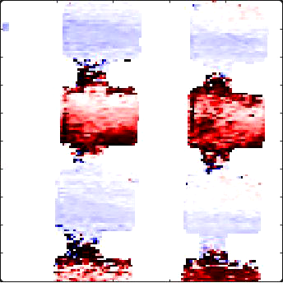
Leaky wave antenna, design #3 (E3)
Data: 2017-11-29_leaky_E3_PH_X_10 Setpoint=1.20 V
k
Light incident from below

Slide 9
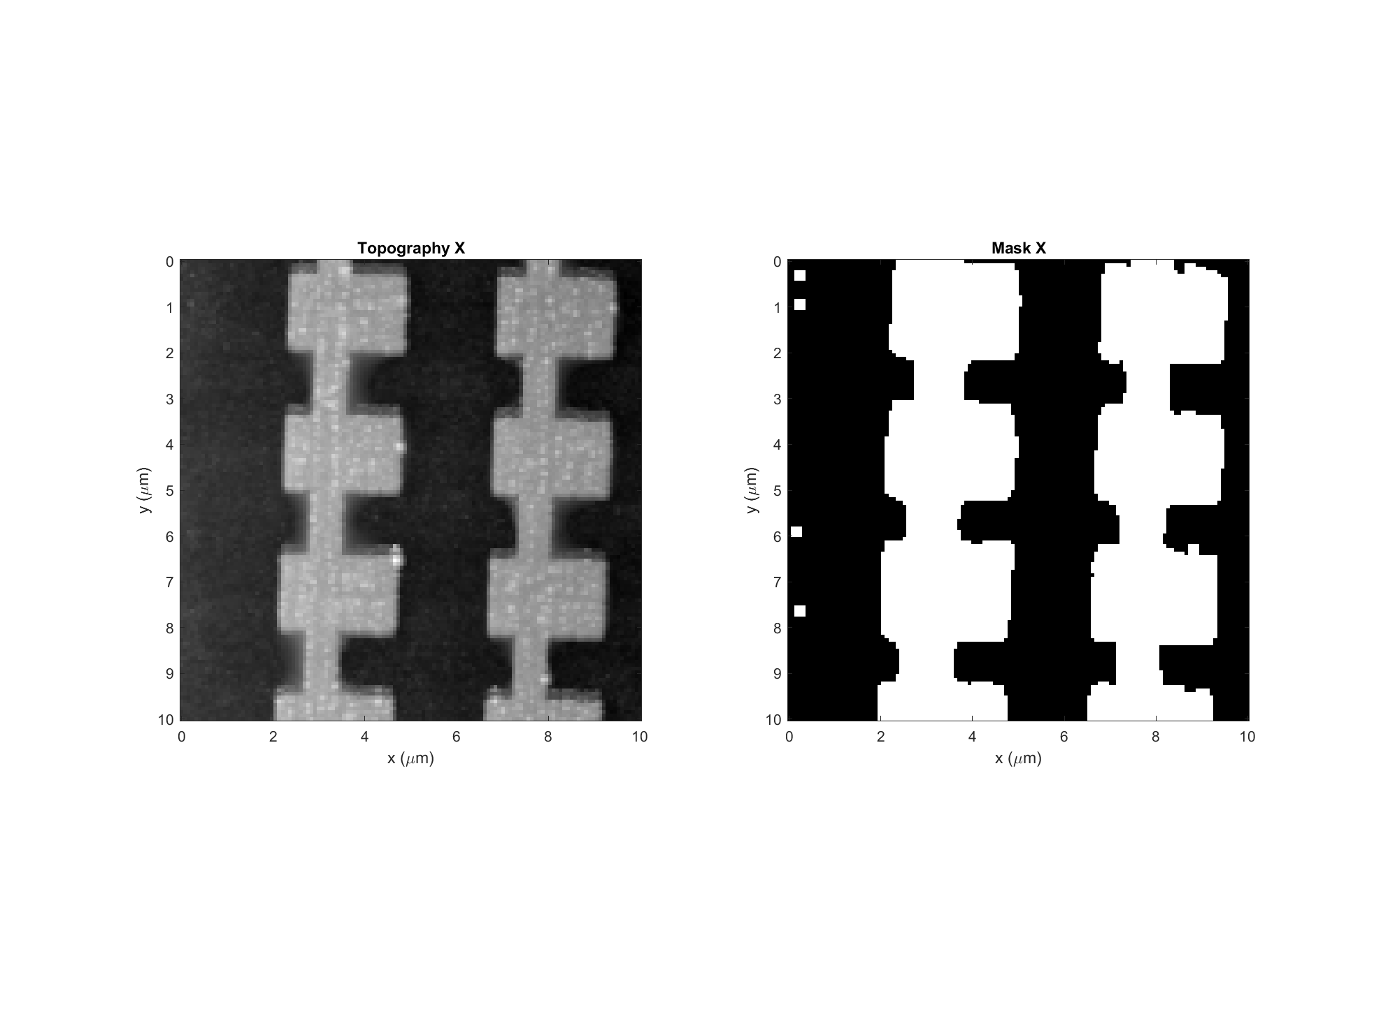
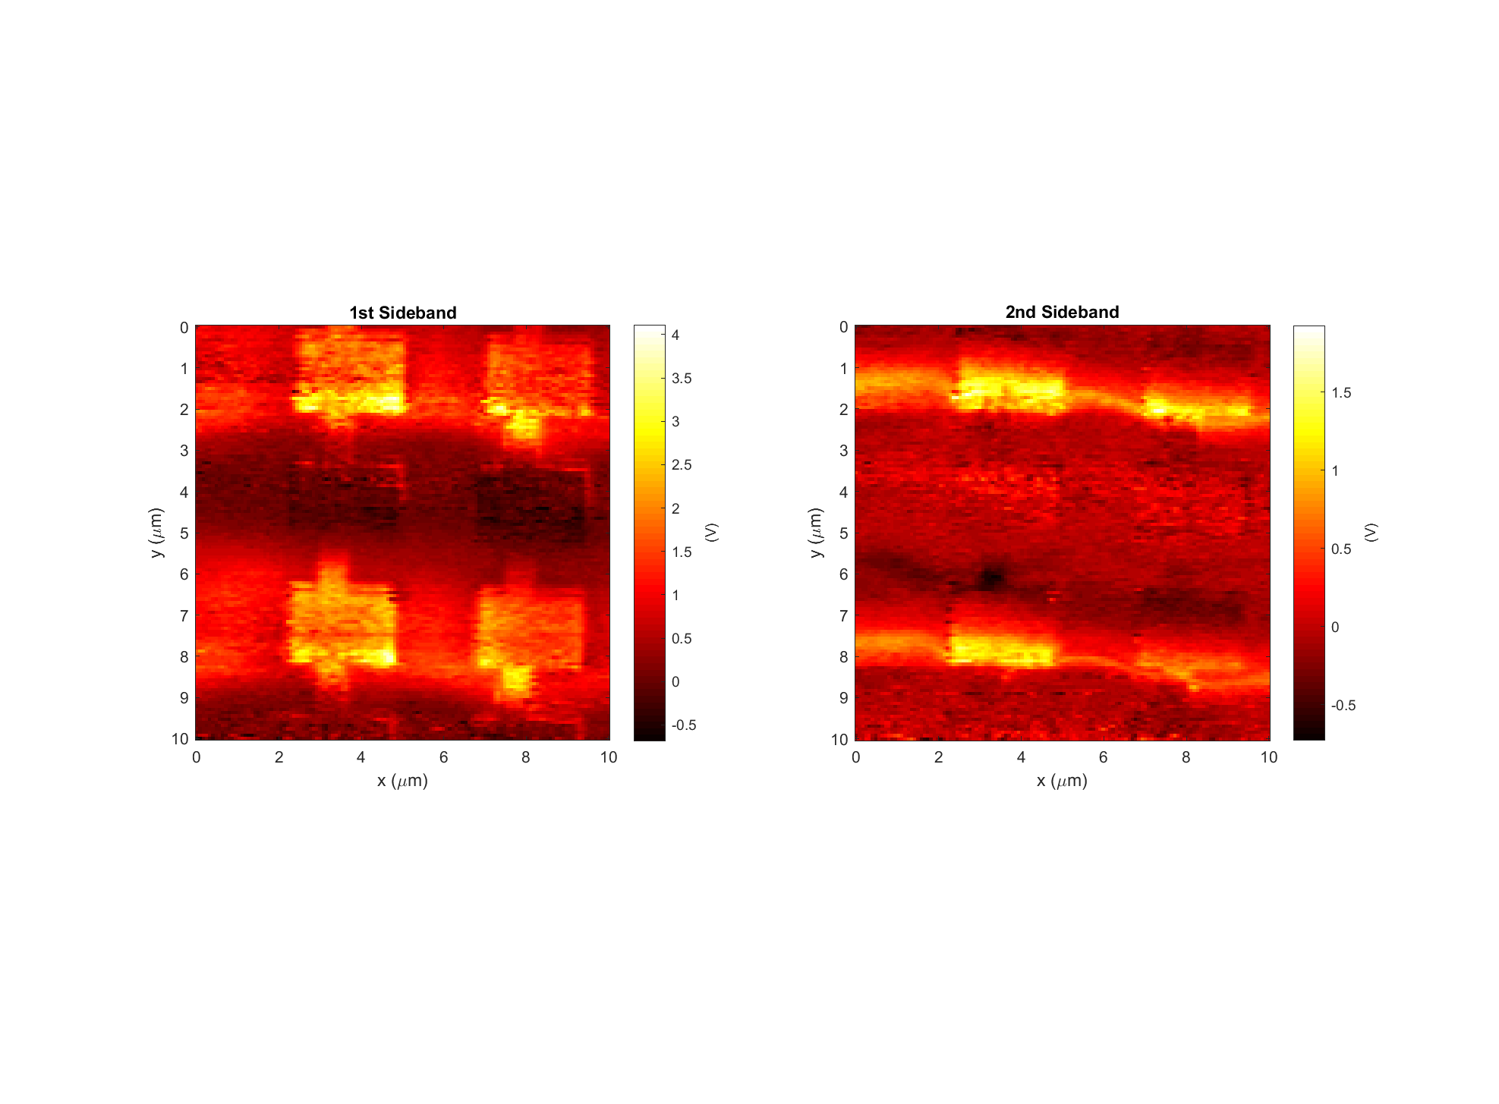
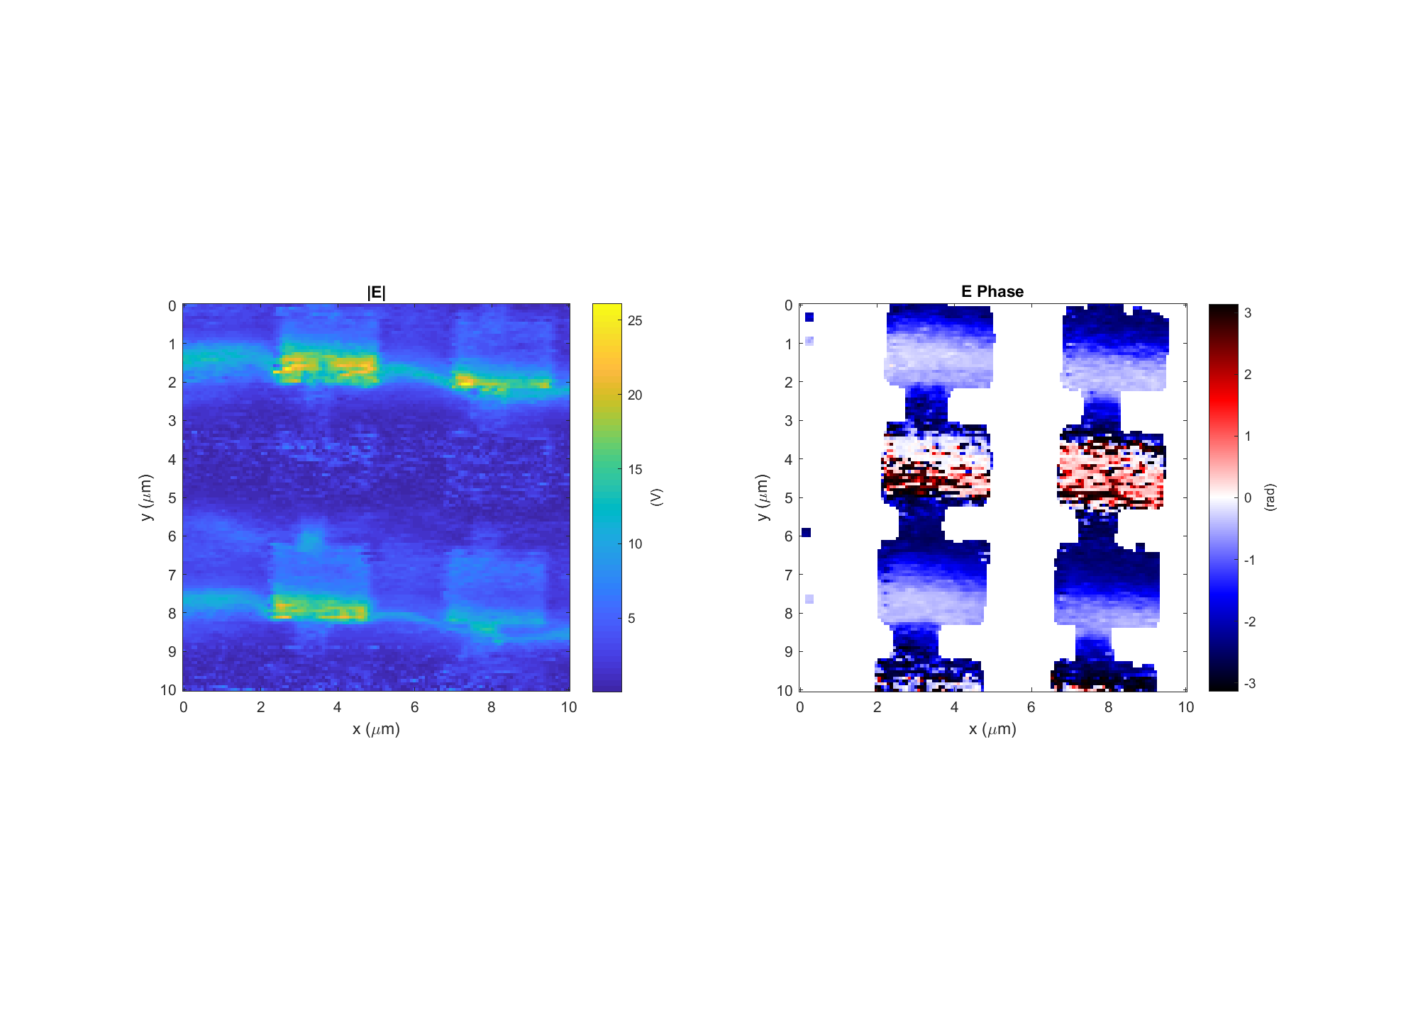
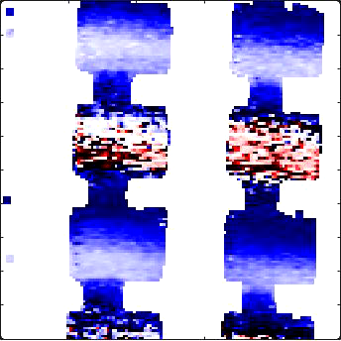
Leaky wave antenna, design #3 (E3)
Data: 2017-11-29_leaky_E3_PH_X_12 Setpoint=1.18 V
k
Light incident from below

Slide 10
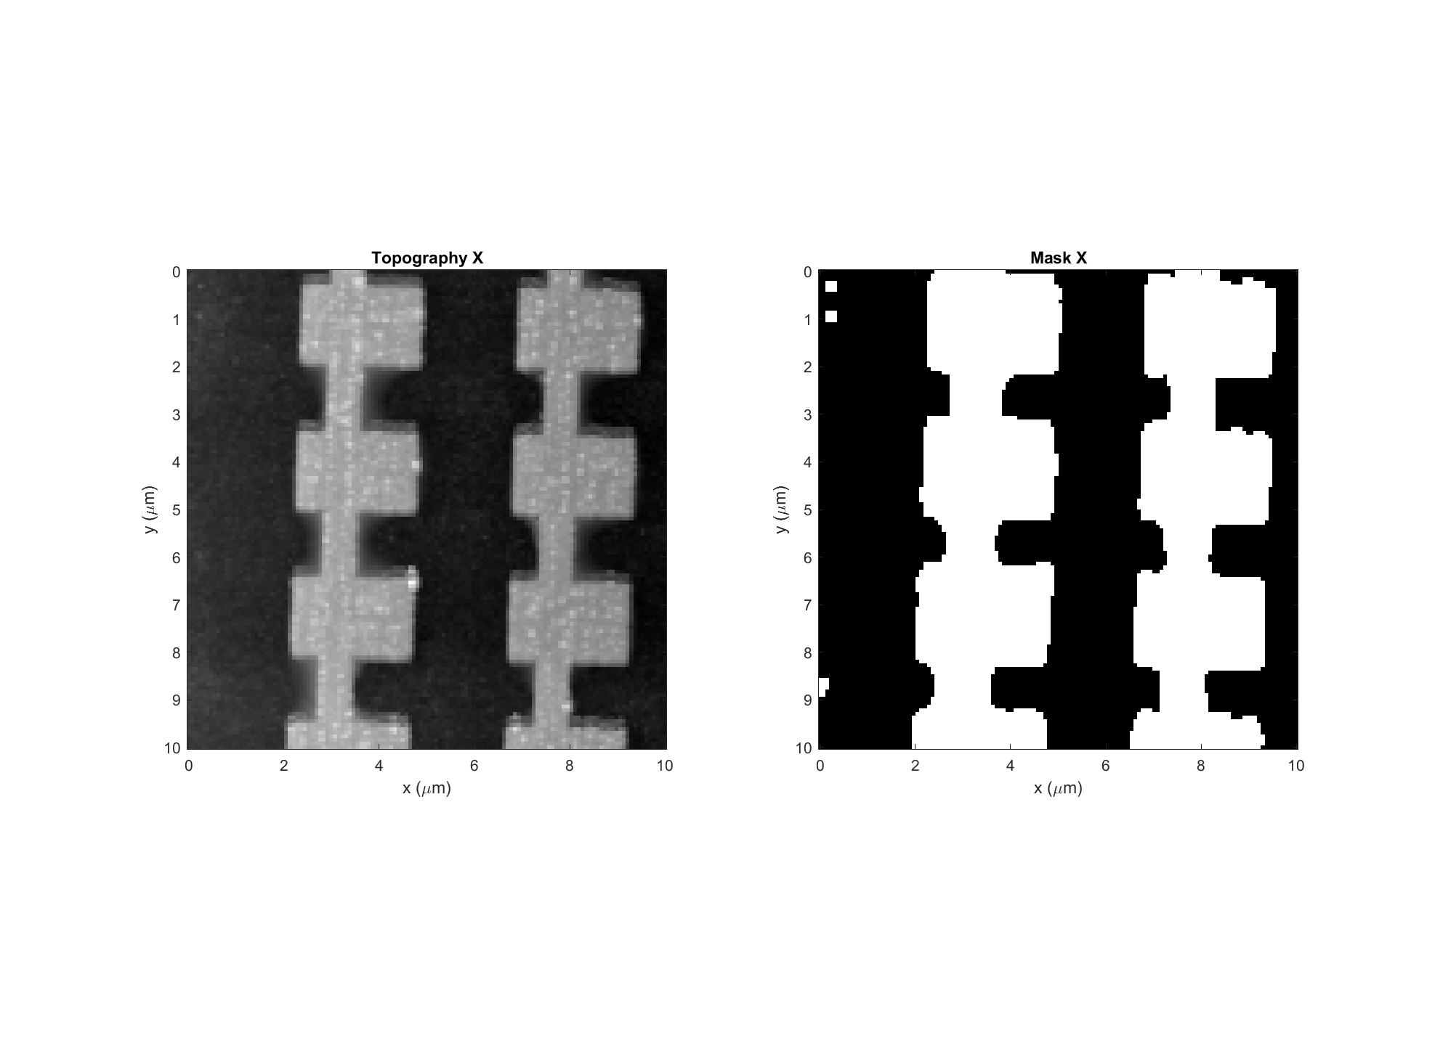
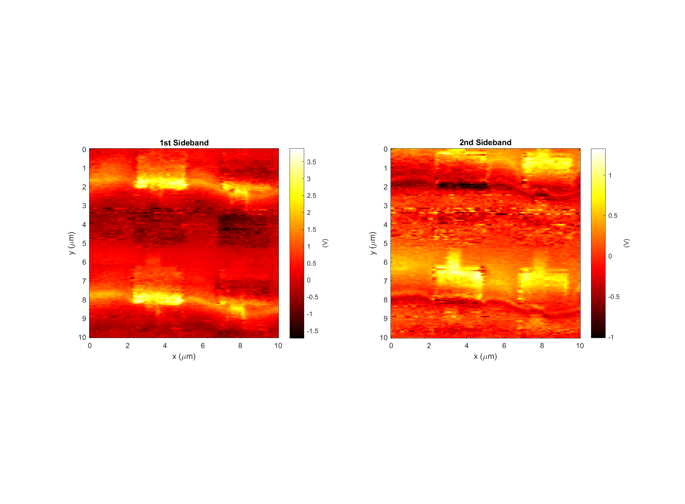
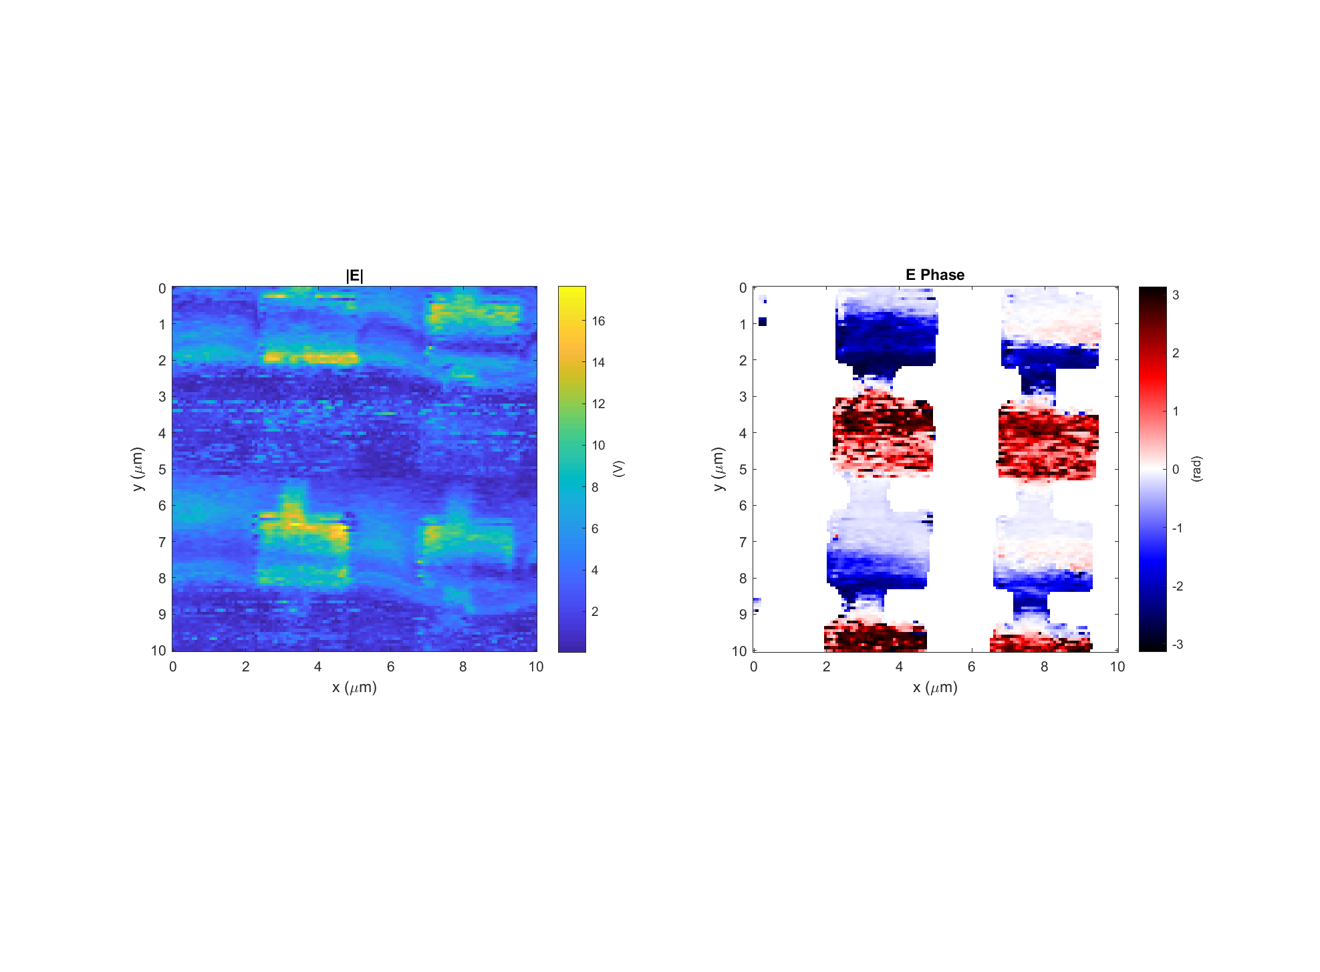
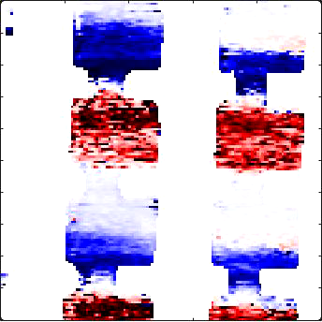
Leaky wave antenna, design #3 (E3)
Data: 2017-11-29_leaky_E3_PH_X_14 Setpoint=1.14 V
k
Light incident from below

Slide 11
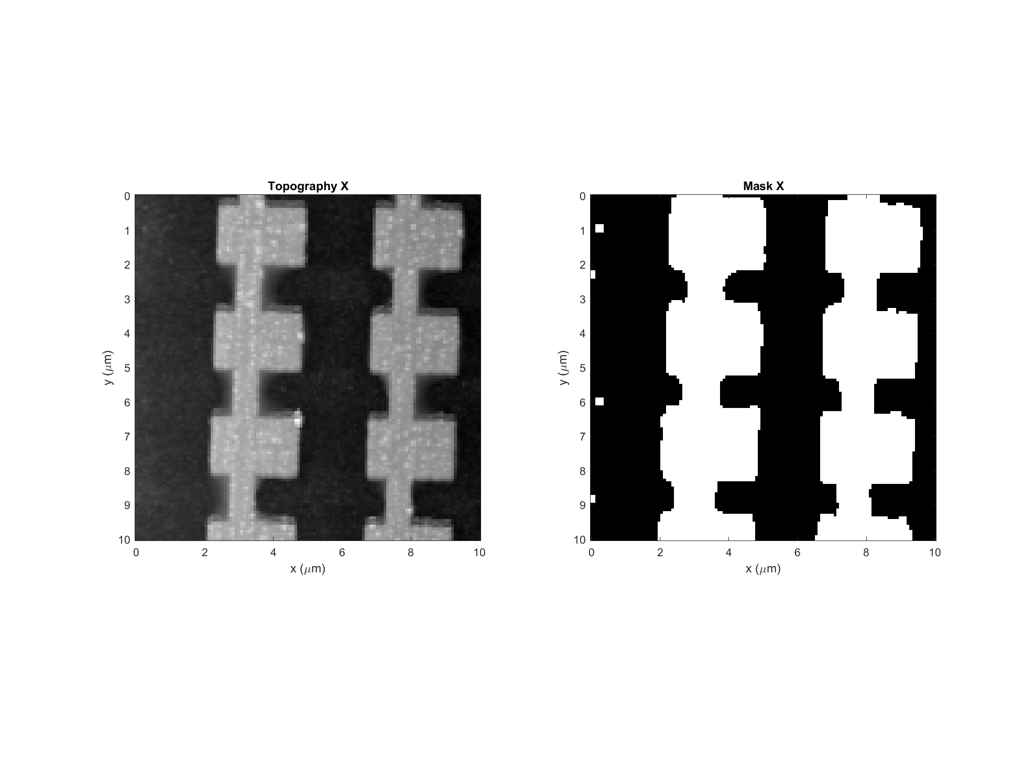
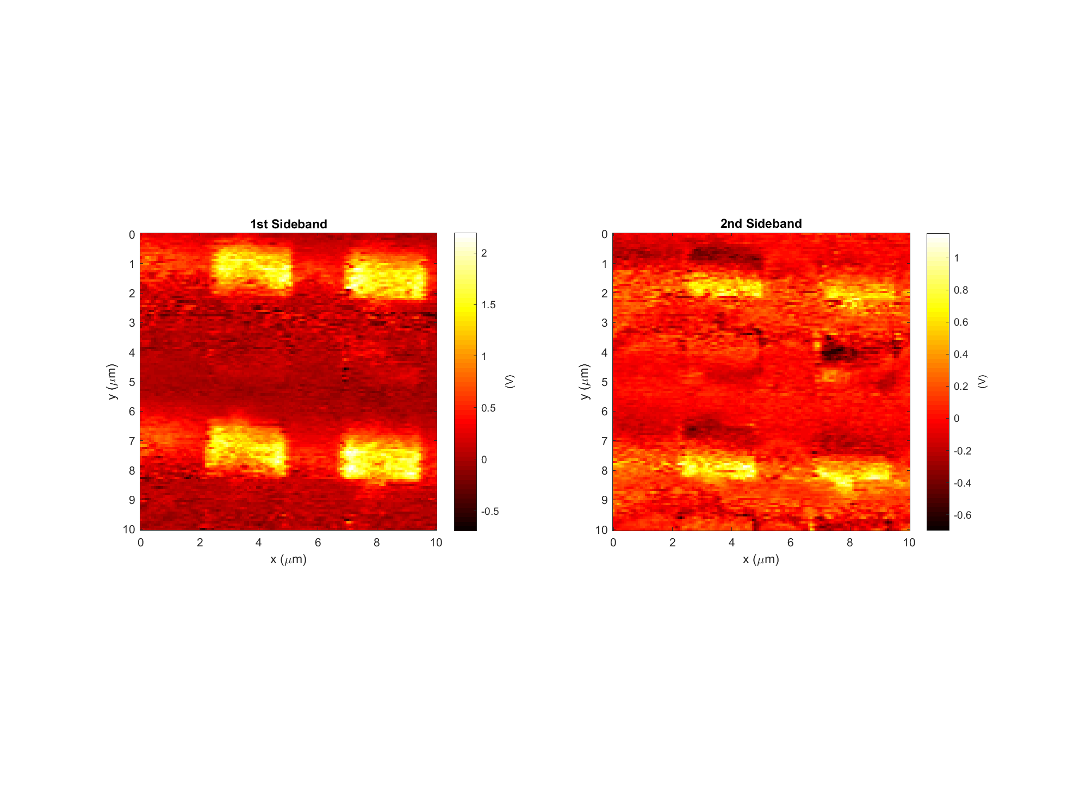
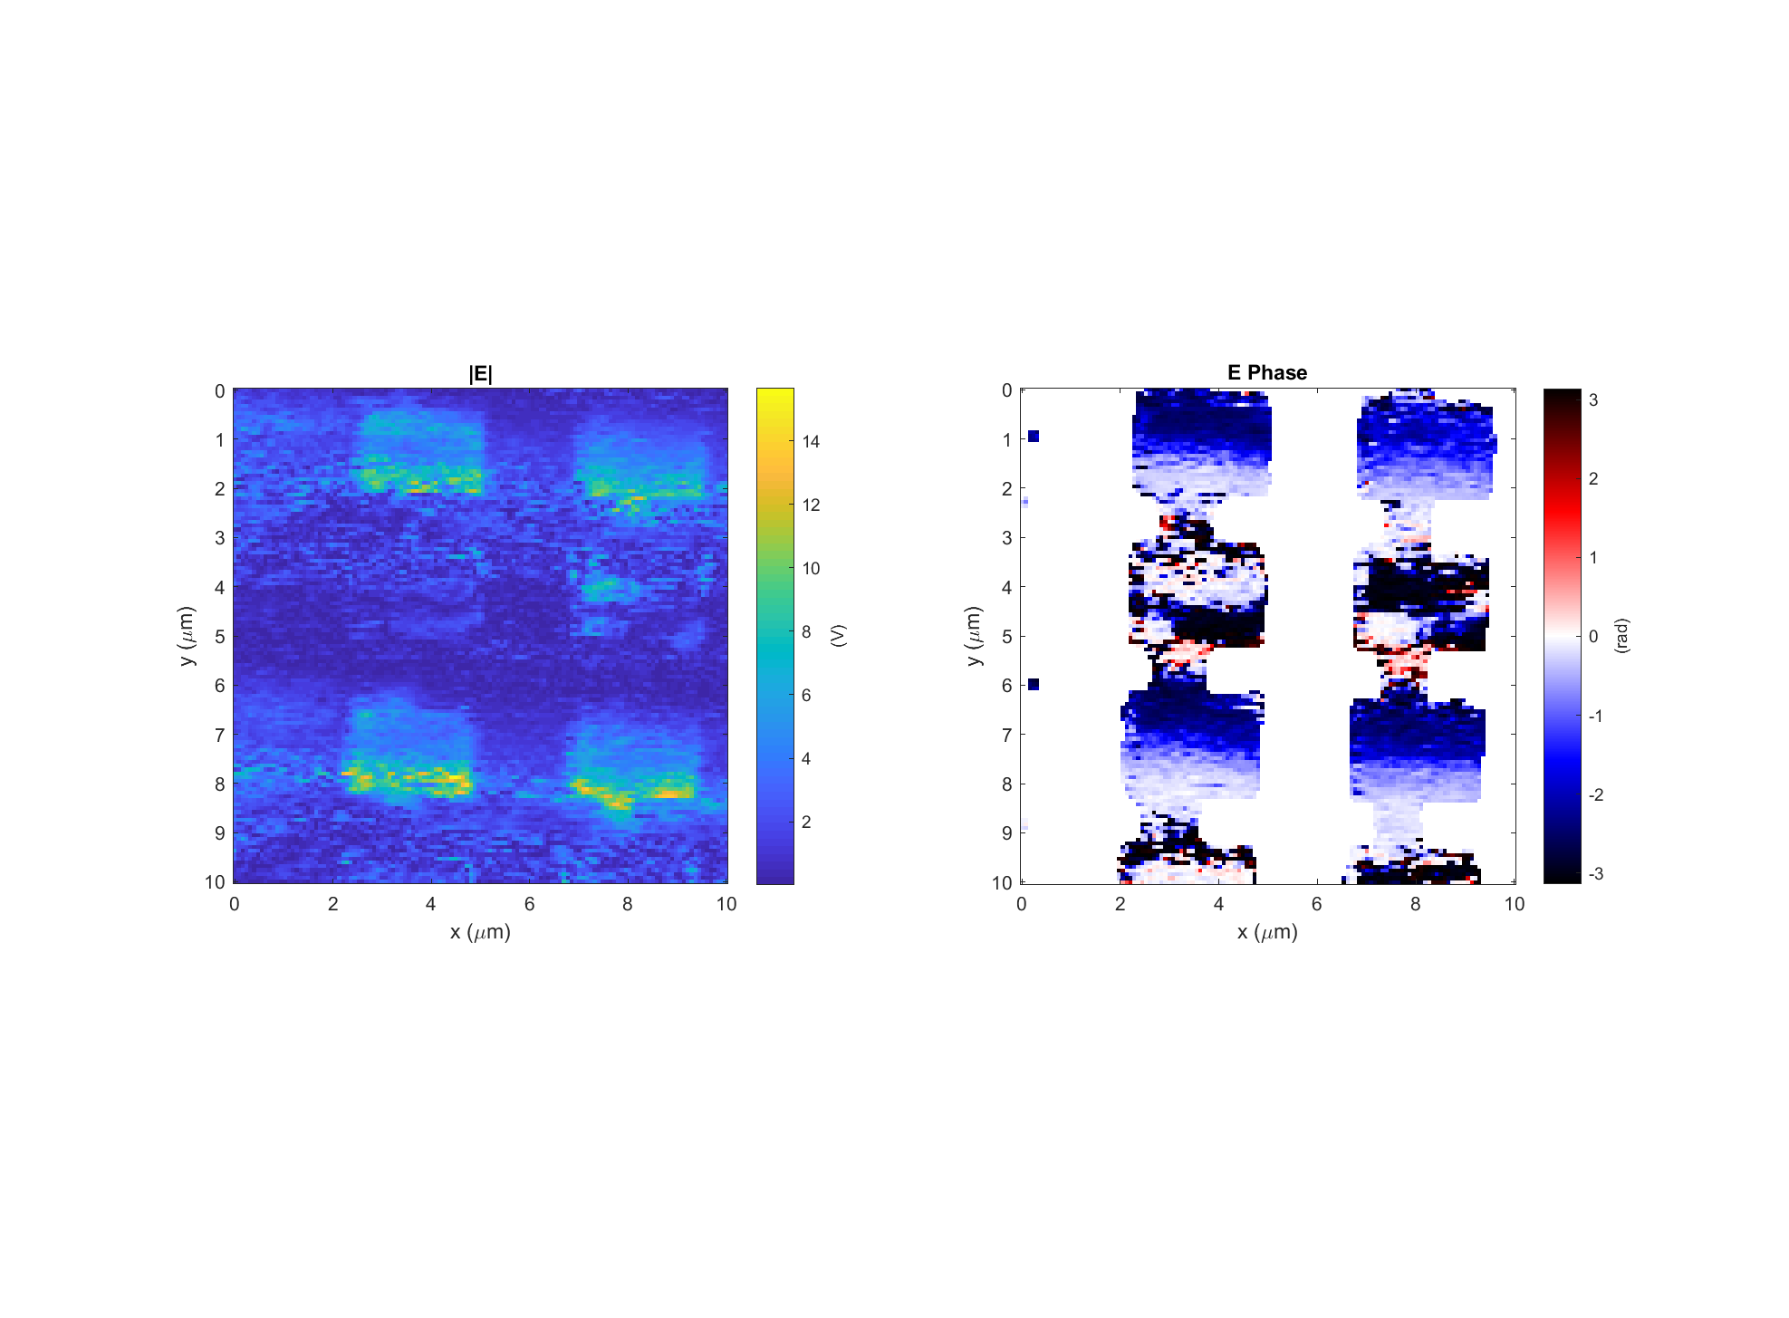
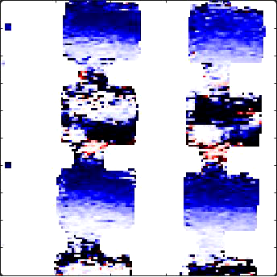
Leaky wave antenna, design #3 (E3)
Data: 2017-11-29_leaky_E3_PH_X_16 Setpoint=1.10 V
k
Light incident from below

Slide 12
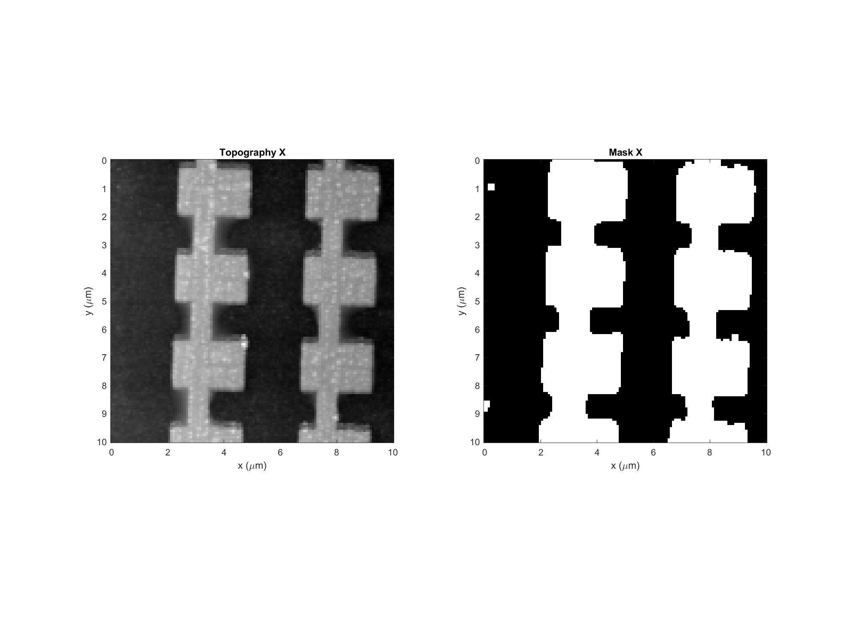
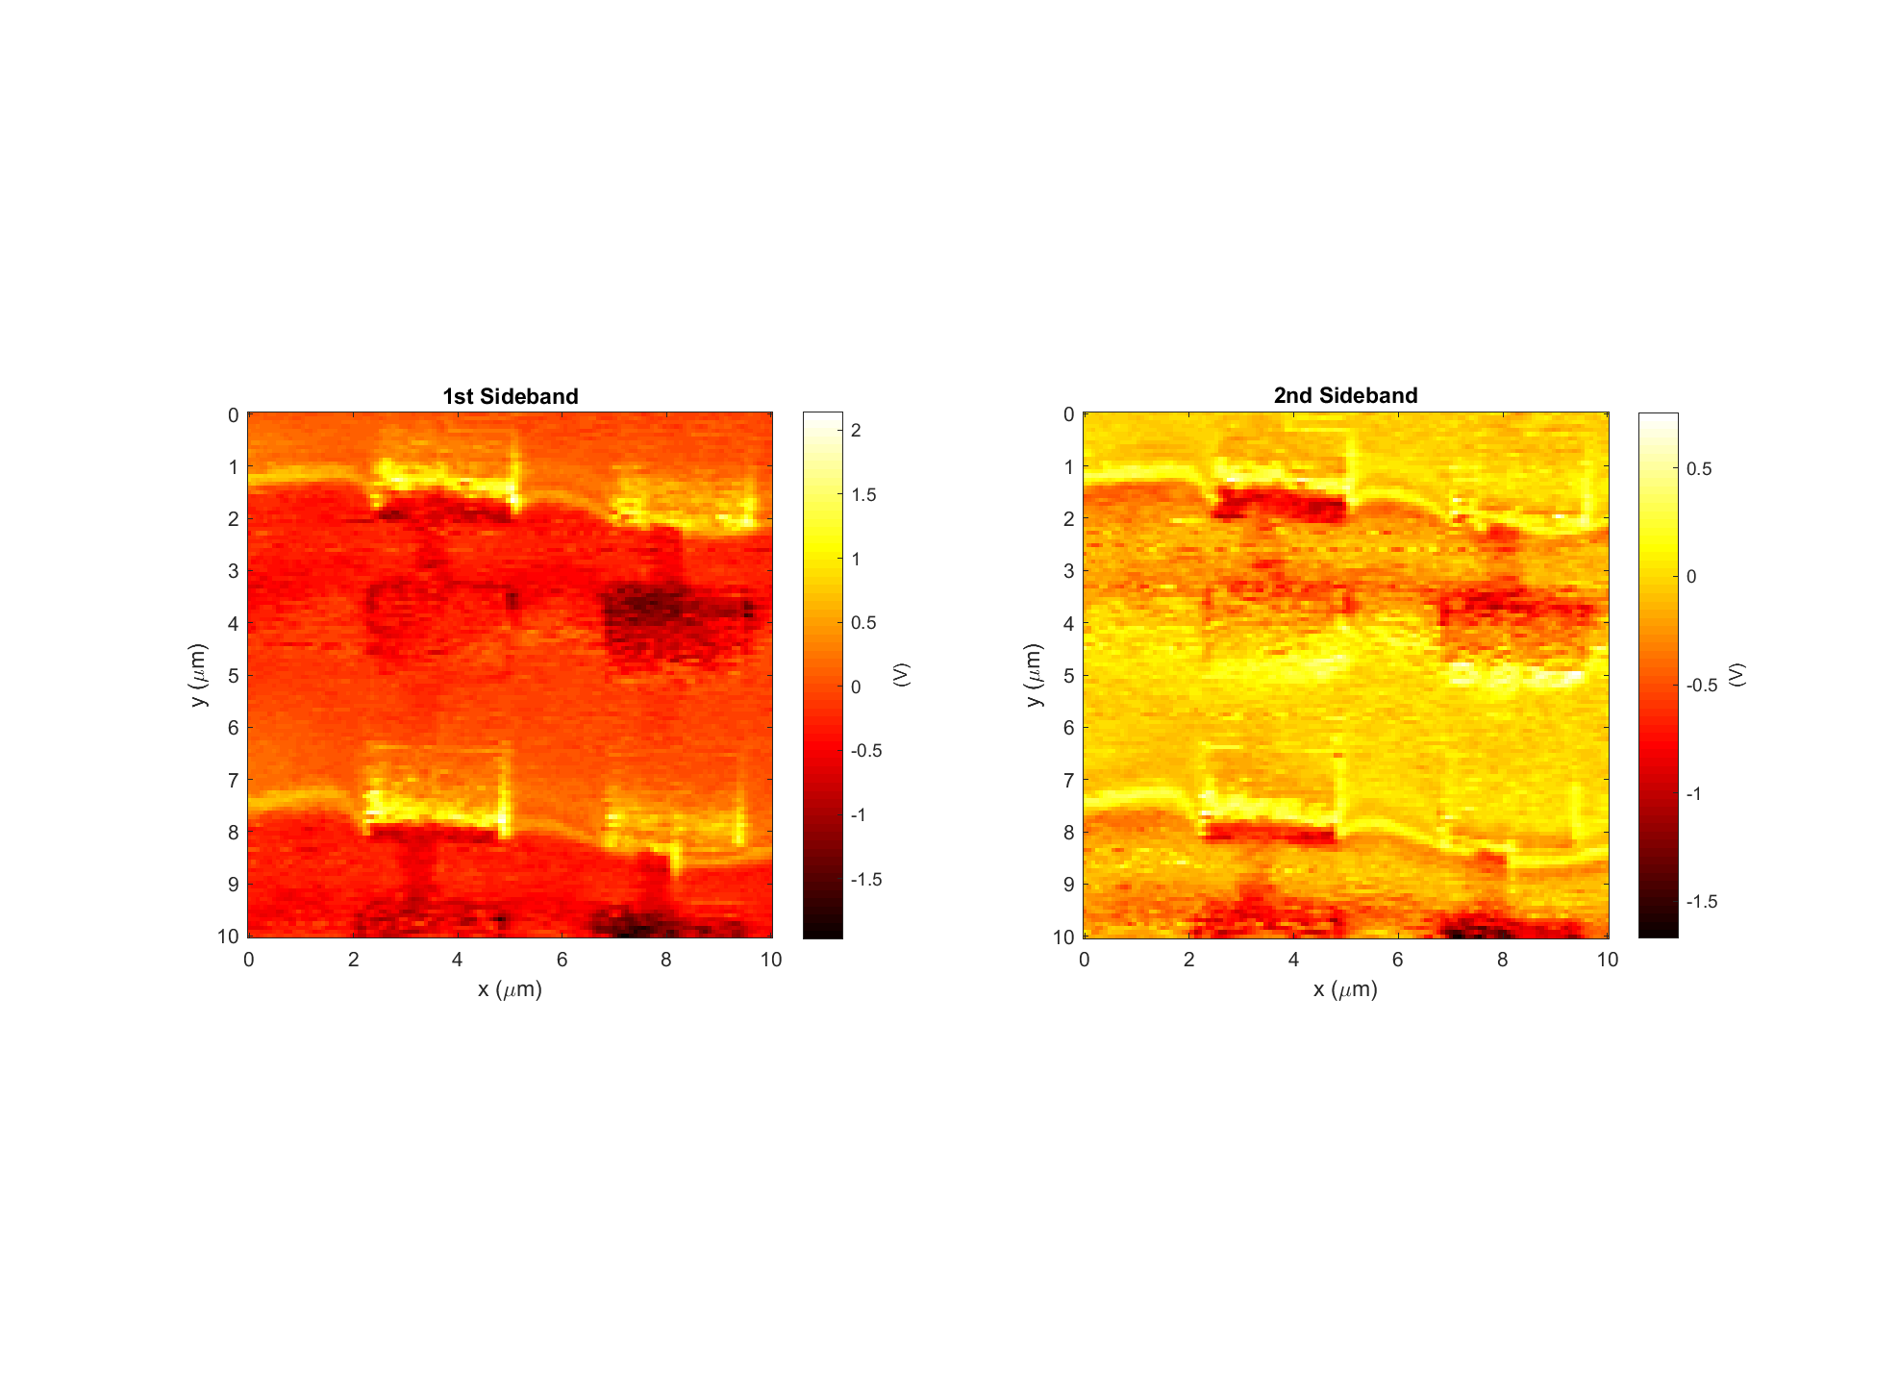
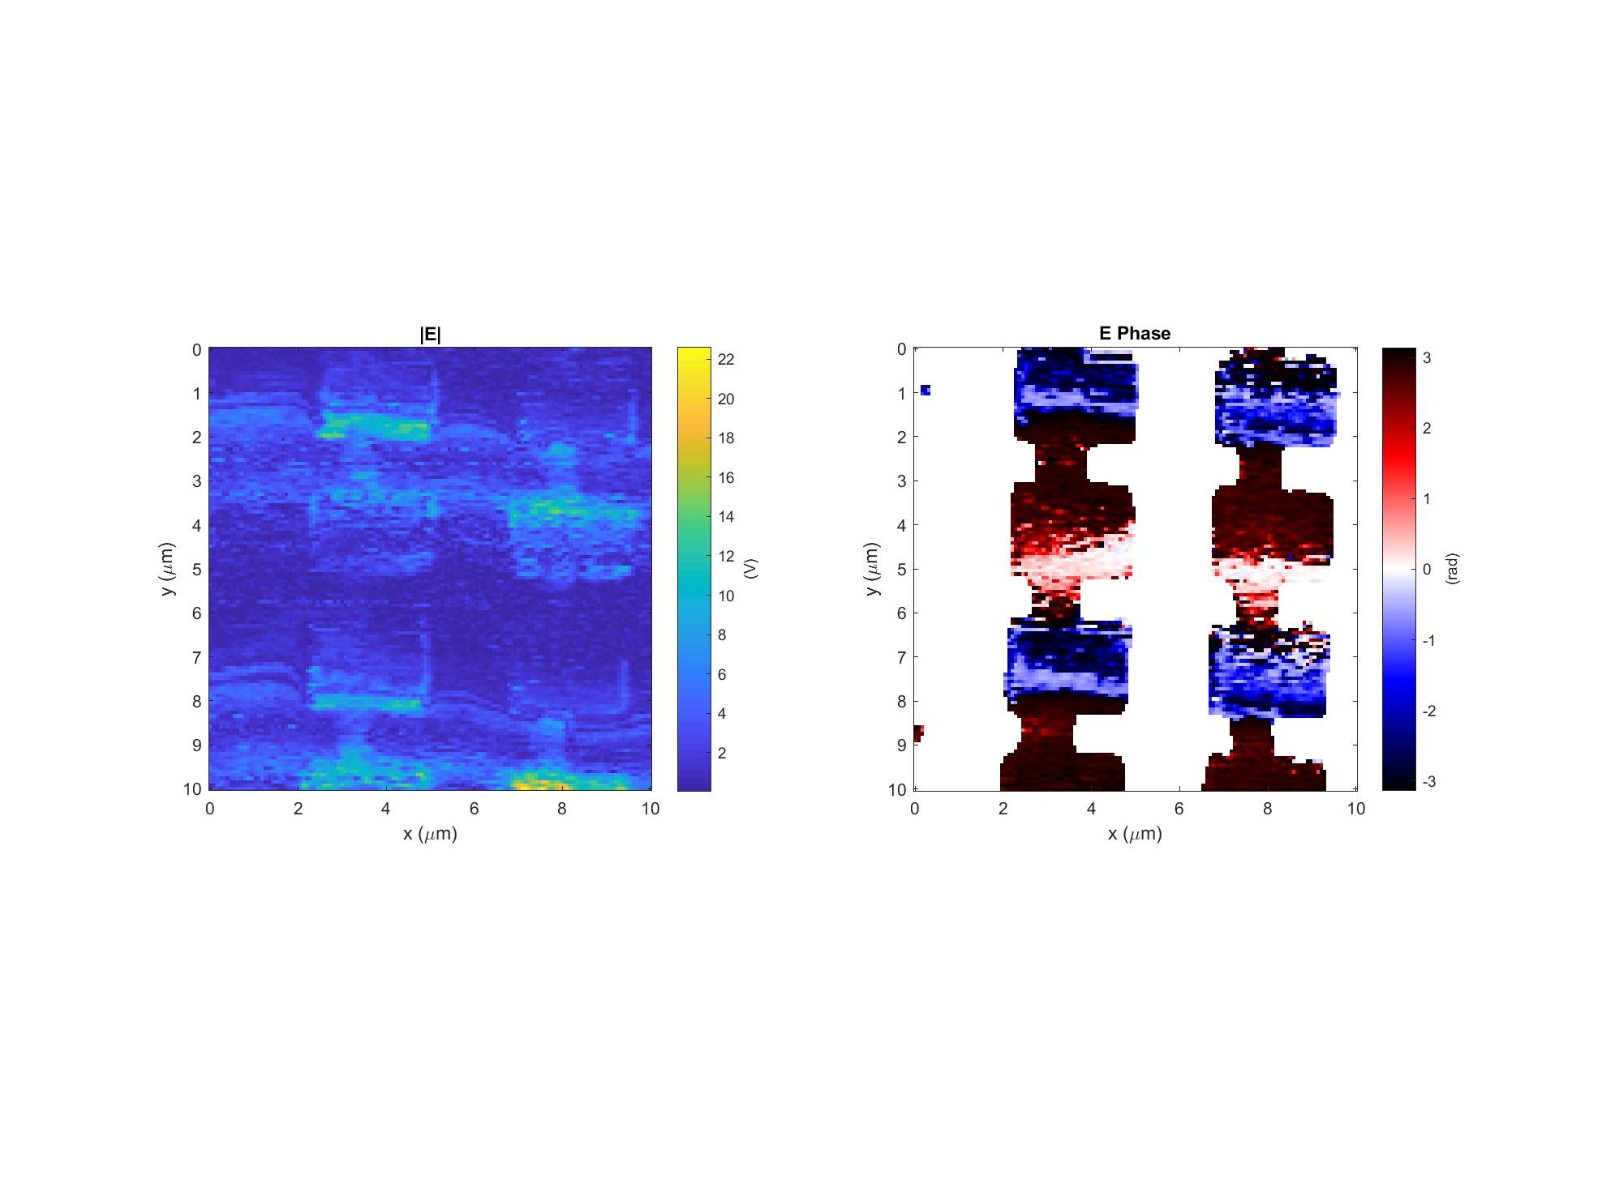
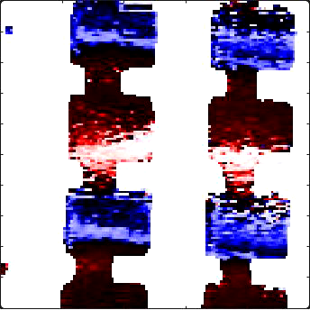
Leaky wave antenna, design #3 (E3)
Data: 2017-11-29_leaky_E3_PH_X_18 Setpoint=1.06 V
k
Light incident from below

Slide 13

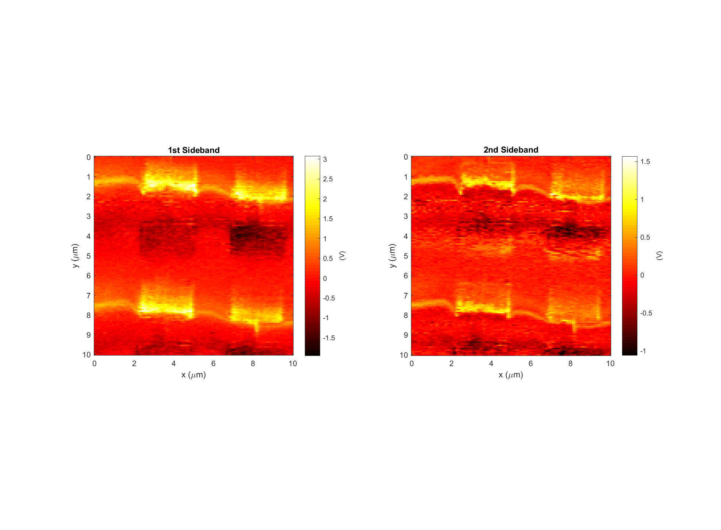
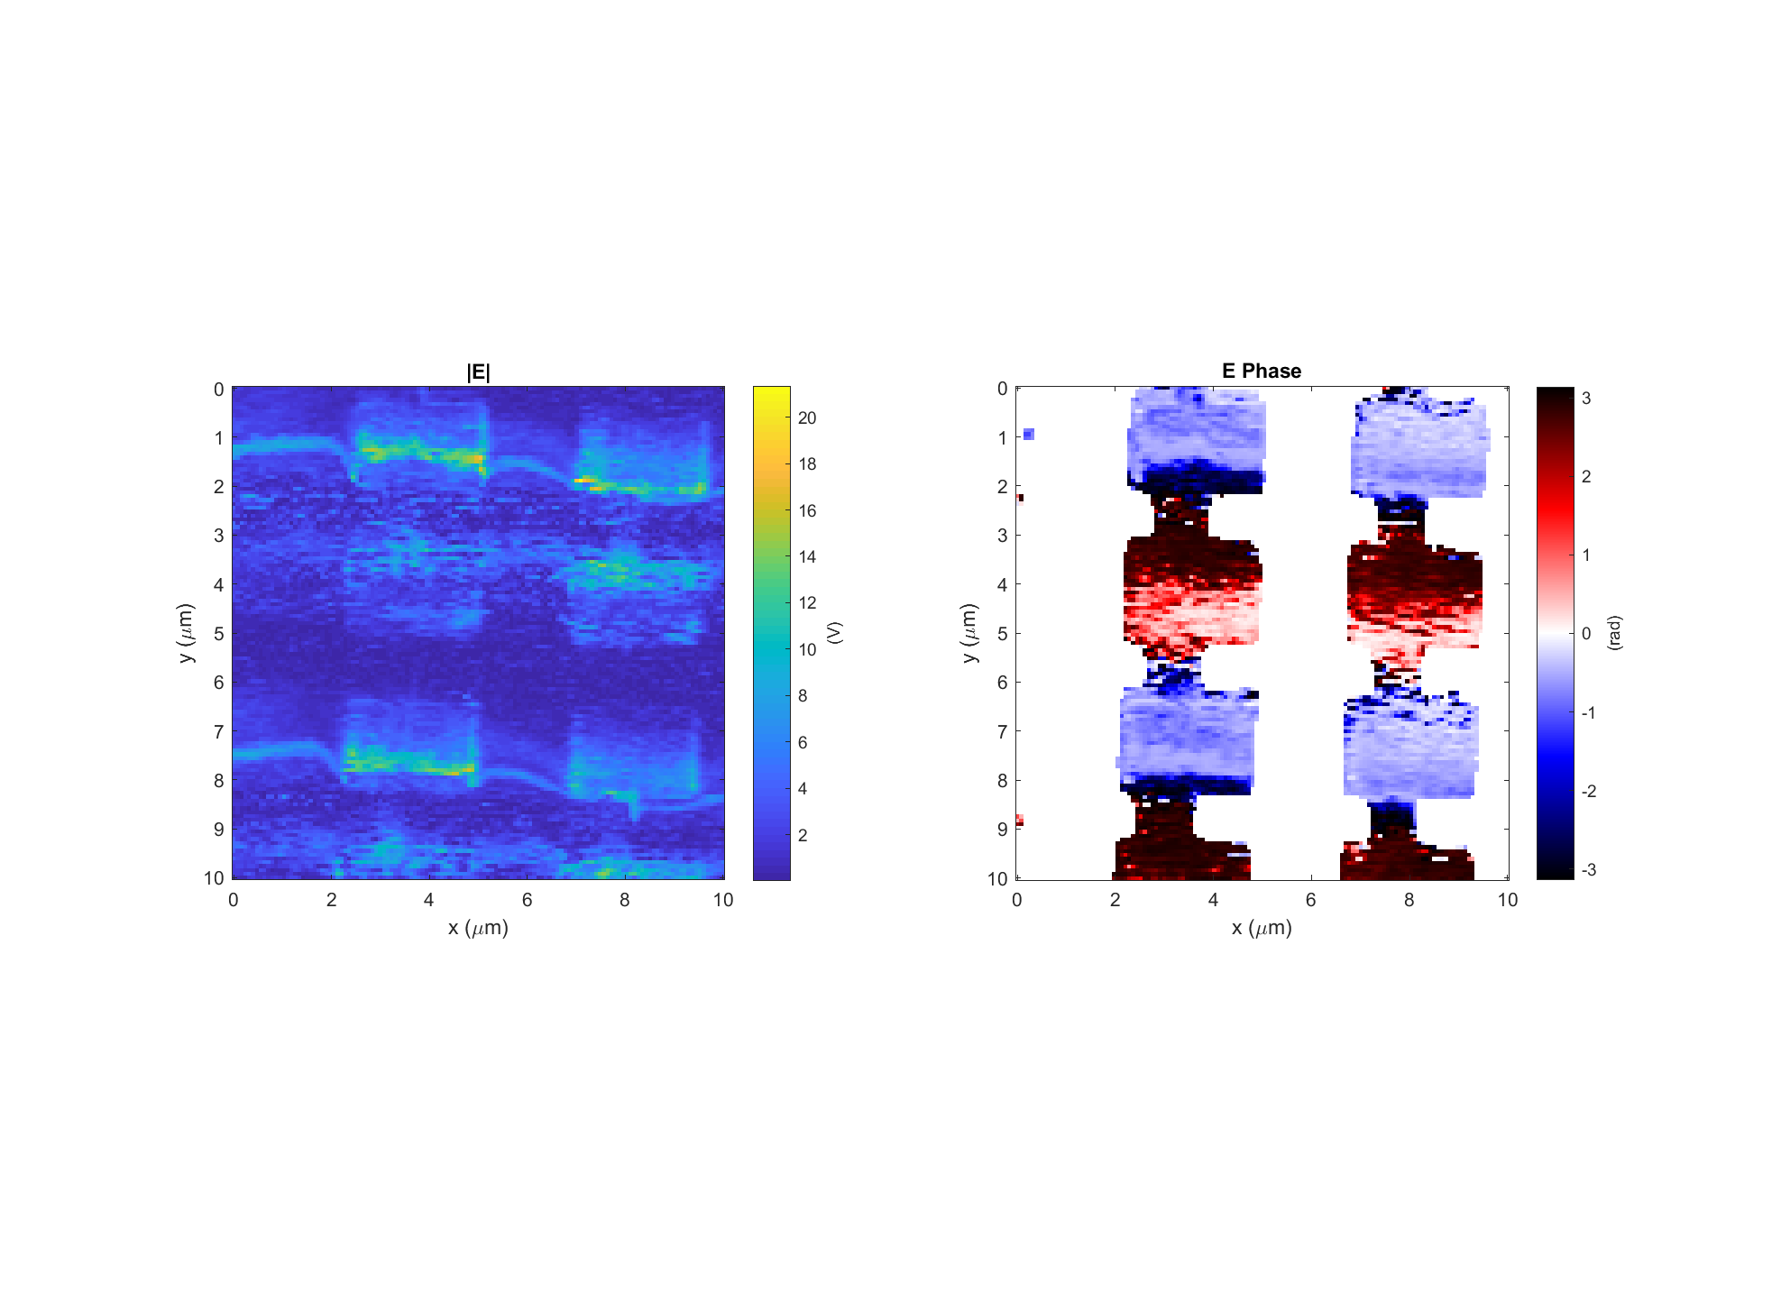
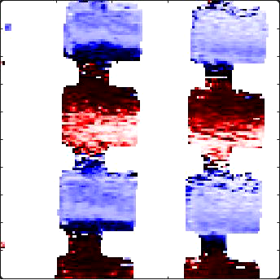
Leaky wave antenna, design #3 (E3)
Data: 2017-11-29_leaky_E3_PH_X_19 Setpoint=1.04 V
k
Light incident from below

Slide 14
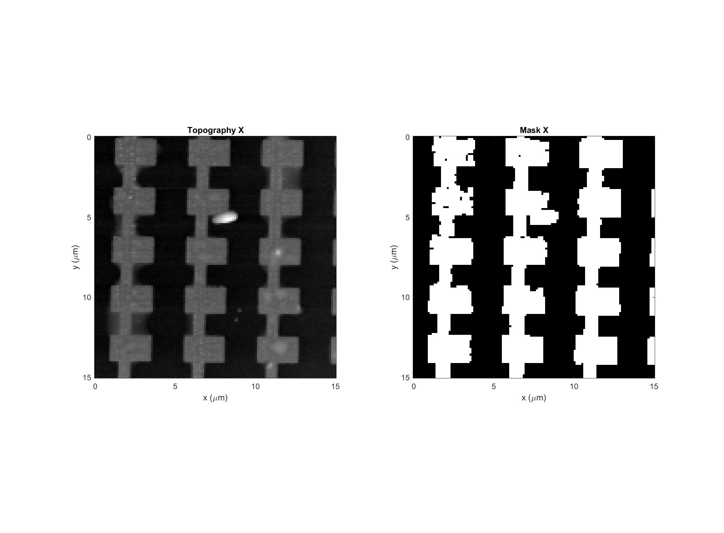
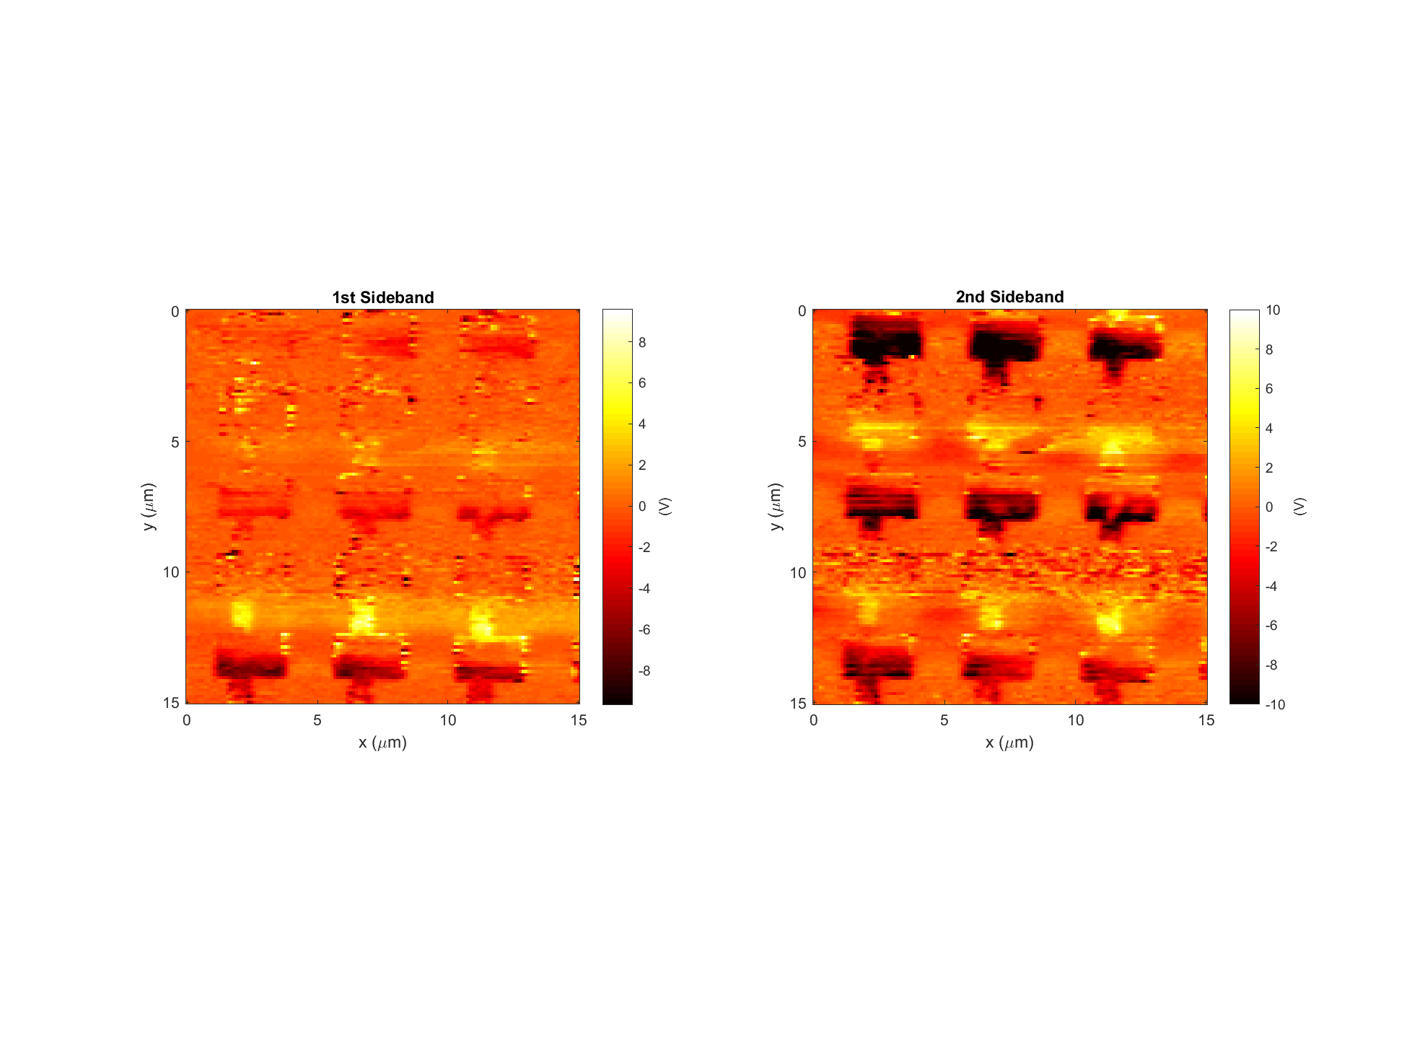
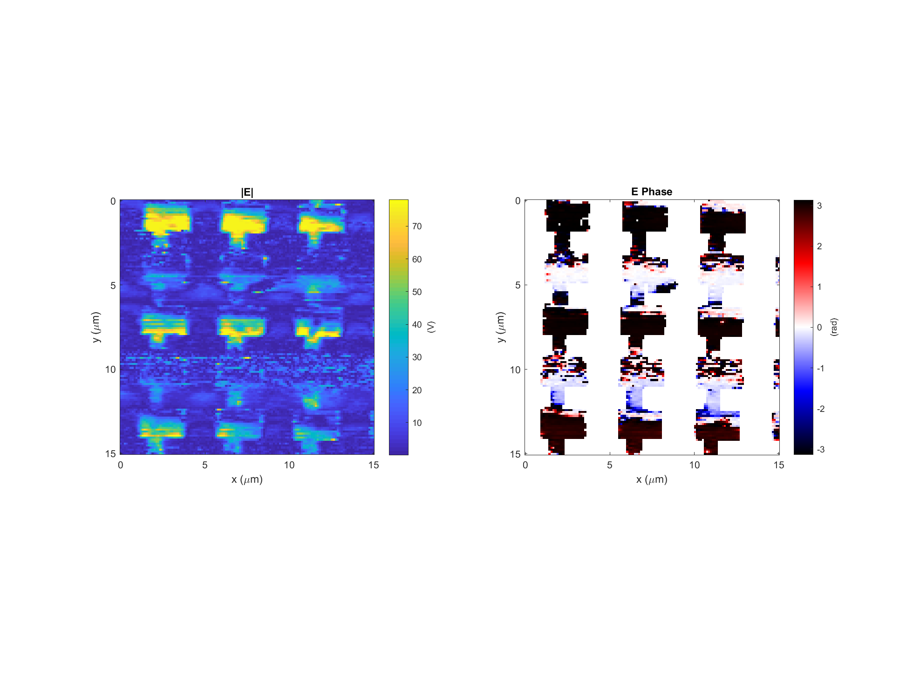
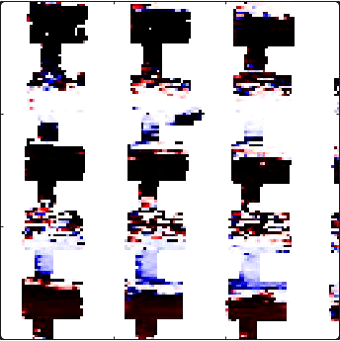
Leaky wave antenna, design #4 (E4)
Data: 2017-12-06_leaky_E4_PH_X_6
k
Light incident from below

